Slide 1

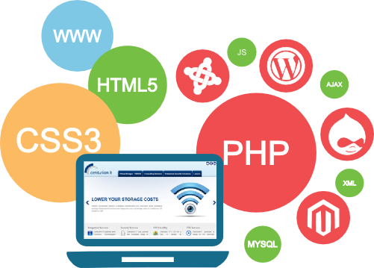
Unit-1
Introduction to WWW

Slide 2
Outline
Introduction
What is WWW?
What is Internet?
HTTP
HTTP Request
HTTP Response
Web Browsers
Features of Web 2.0

Slide 3
What is WWW?
WWW stands for World Wide Web.
A technical definition of the WWW is − All the resources and users on the Internet that are using HTTP.
HTTP stands for Hypertext Transfer Protocol.
This is the protocol being used to transfer hypertext documents that makes the World Wide Web possible.

Slide 4



How the Web Works?
World Wide Web (WWW) use classical client / server architecture
Hyper Text Transfer Protocol is text-based request-response protocol
Server running Web Server Software (IIS, Apache, etc.)
Client running a Web Browser
HTTP
Page request
HTTP
Server response

Slide 5
What is the Internet?
The Internet is a massive network of networks, a networking infrastructure.
It connects millions of computers together globally, forming a network in which any computer can communicate with any other computer as long as they are both connected to the Internet.
Information that travels over the Internet uses many different set of rules which are known as protocols.

Slide 6
HTTP Request
Request Method
GET
POST
PUT
DELETE
Etc….
Request Header Fields
Accept-Charset, Accept-Encoding, Accept-Language, User-Agent, Host

Slide 7
HTTP Request (Example)
GET /hello.html HTTP/1.1 |  | hello.html is requested from server using GET method of HTTP version 1.1
User-Agent: Mozilla/4.0 |  | Client is using version 4 of the mozila browser
Host: www.abc.com |  | Host of the page is abc.com
Accept-Language: en-us |  | Client accepts US English Locale

Slide 8
HTTP Response
Response Header Fields
Date, Server, Last-Modified, Content-Length, Content-Type
Status Code
1** : Information
2** : Success
3** : Redirection
4** : Client Error
5** : Server Error

Slide 9

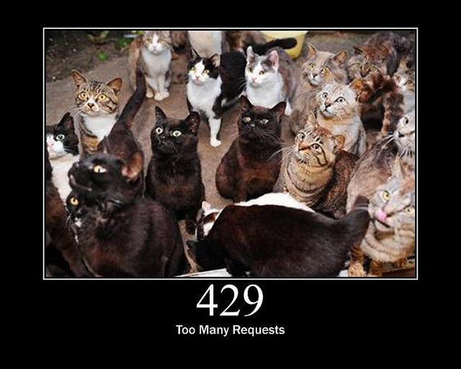
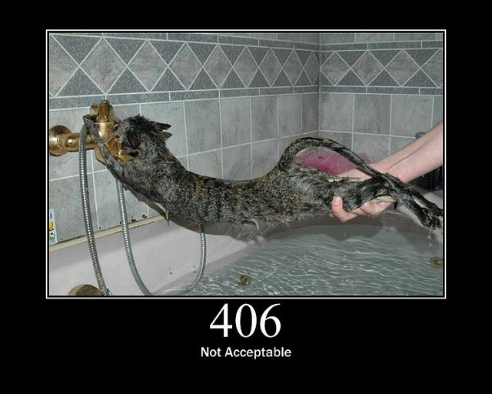

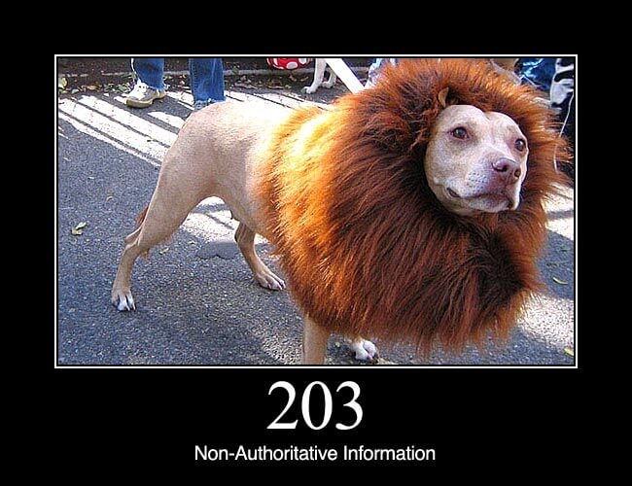

HTTP Status Codes

Slide 10
HTTP Response (Example)
HTTP/1.1 200 OK |  | Response is 200 status code with OK message using HTTP1.1
Date: Mon, 27 Jul 2009 12:28:53 GMT |  | Response Date & Time
Server: Apache/2.2.14 (Win32) |  | Webserver used by server
Last-Modified: Wed, 22 Jul 2009 19:15:56 GMT |  | Last modified at Date & Time
Content-Length: 88 |  | Content-Length in bytes
Content-Type: text/html |  | Content-Type of the response

Slide 11




Web Browsers
A web browser or Internet browser is a software application for retrieving, presenting, and traversing information resources on the World Wide Web.
Example :
An information resource is identified by a Uniform Resource Identifier (URI) and may be a web page, image, video, or other piece of content.
Hyperlinks present in resources enable users to easily navigate their browsers to related resources
Mozila Firefox
Google Chrome
Opera
Internet Explorer

Slide 12
Features of Web 2.0
Folksonomy | Social Tagging
Traditional Web like Yahoo Directory and DMOZ uses a pre-defined classification of Information like category & sub category.
On the other hand Web 2.0 without sticking to the existing framework of classification , allows user to create free classification/ arrangement of information.
This is also known as Social tagging.
Wikis
Wikis - sites like Wikipedia and others enable users from around the world to add and update online content
Social Networking
Sites like Facebook and MySpace allow users to build and customize their own profiles and communicate with friends.

Slide 13
Features of Web 2.0 (Cont.)
User Participation
In traditional web the contents are solely provided by the website owner or company, but in web 2.0 the users participate in content sourcing. This is also known as Crowd sourcing. Examples: Wikipedia & YouTube.
Long Tail
The traditional web was like a retail business the product is sold directly to user and the revenue generated. But in web 2.0 the niche product is not sold directly but offered as a service on demand basis and income is generated as monthly fee and pay per consumption.
Rich User Experience
Traditional web are built with HTML and CSS CGI and had been offered as a static page. On the other hand Web 2.0 uses Ajax(Asynchronous JavaScript + XML) presenting dynamic, rich user experience to users.

Slide 14
Web Design

Slide 15
Outline
Web Design Issues
Planning a website
Effective Navigation

Slide 16
Web Design Issues
Browser & Operating Systems
Bandwidth and Cache
Display Resolution
Look & Feel
Page Layout and Linking
Locating Information
Making Design user-Centric
Sitemap

Slide 17
a) Browser & Operating Systems
Web pages are written using different HTML tags and viewed in browser window.
The different browsers and their versions greatly affect the way a page is rendered, as different browsers sometimes interpret same HTML tag in a different way.
Different versions of HTML also support different sets of tags.
The support for different tags also varies across the different browsers and their versions.
Same browser may work slightly different on different operating system and hardware platform.
To make a web page portable, test it on different browsers on different operating systems.

Slide 18
b) Bandwidth and Cache
Users have different connection speed, i.e. bandwidth, to access the Web sites.
Connection speed plays an important role in designing web pages, if user has low bandwidth connection and a web page contains too many images, it takes more time to download.
Generally, users have no patience to wait for longer time than 10-15 seconds and move to other site without looking at contents of your web page.
Browser provides temporary memory called cache to store the graphics.
When user gives the URL of the web page for the first time, HTML file together with all the graphics files referred in a page is downloaded and displayed.

Slide 19
c) Display Resolution
Display resolution is another important factor affecting the Web page design, as we do not have any control on display resolution of the monitors on which user views our pages.
Display or screen resolution is measured in terms of pixels and common resolutions are 800 X 600 and 1024 X 786.
We have three choices for Web page design.
Design a web page with fixed resolution.
Make a flexible design using HTML table to fit into different resolution.
If the page is displayed on a monitor with a higher resolution, the page is displayed on left hand side and some part on the right-hand side remains blank. We can use centered design to display page properly.
Ideally we should use some frameworks for designing like Bootstrap/Material design.

Slide 20
d) Look & Feel
Look and feel of the website decides the overall appearance of the website.
It includes all the design aspects such as
Web site theme
Web typography
Graphics
Visual structure
Navigation etc…

Slide 21
e) Page Layout and Linking
Website contains of individual web pages that are linked together using various navigational links.
Page layout defines the visual structure of the page and divides the page area into different parts to present the information of varying importance.
Page layout allows the designer to distribute the contents on a page such that visitor can view it easily and find necessary details.

Slide 22
f) Locating Information
Webpage is viewed on a computer screen and the screen can be divided into five major areas such as center, top, right, bottom and left in this particular order.
The first major area of importance in terms of users viewing pattern is the center, then top, right, bottom and left in this particular order

Slide 23
g) Making Design user-Centric
It is very difficult for any Web designer to predict the exact behavior of the Web site users.
However, idea of general behavior of common user helps in making design of the Web site user centric.
Users either scan the information on the web page to find the section of their interest or read the information to get details.

Slide 24
h) Sitemap
A Sitemap is a model of a website's content designed to help both users and search engines navigate the site.
Many a times Web sites are too complex as there are a large number of sections and each section contains many pages.
It becomes difficult for visitors to quickly move from one part to other.
Once the user selects a particular section and pages in that section, user gets confused about where he/she is and where to go from there.
To make it simple, keep your hierarchy of information to few levels or provide the navigation bar on each page to jump directly to a particular section.

Slide 25
Planning a Website
The most important activity in a website development is planning.
To achieve higher success of the website in terms of user satisfaction, better planning is needed.
Before we start developing a website, we should ask question such as
Why are we developing this website?
What do we achieve by developing this website?
Who are the people who will use this website?
What are the information contents?
How are these contents organized? What are the possible ways?

Slide 26
Effective Navigation
The most important design element in the web design after page layout is navigation design.
Navigation means the ways to move from one page to another page in a Web site using hyperlinks provided on the page.
If navigation design is not proper then user feels the problem in moving around the pages in your site in a desired manner or gets confused and leaves the site.

Slide 27
Tips for Effective Navigation
Navigation links are either text based, i.e. a word or a phrase is used as a link, or graphical, i.e. a image, a icon or a logo is used as a link.
Navigation links should be clear and meaningful.
It should be consistent.
Link should be understandable.
Organize the links such that contents are grouped logically.
Provide search link, if necessary, usually on top of the page.
Use common links such as ‘about us’ or ‘Contact us’.
Provide the way to return to first page.
Provide the user with information regarding location
Horizontal navigation bar can be provided on each page to directly jump to any section

Slide 28
Unit-2
Introduction to HTML

Slide 29
Outline
Introduction to HTML
What is a Web Page?
My First HTML Page
HTML Code Formatting
Basic HTML Tags
Heading
Paragraph
Color
Font
List
Anchor
Image
HTML Tables
HTML Forms
XHTML
Introduction to HTML 5

Slide 30
What is a Web Page?
Web page is text file containing HTML
HTML – Hyper Text Markup Language
A notation for describing
document structure (semantic markup)
formatting (presentation markup)
The markup tags provide information about the page content structure

Slide 31
Creating HTML Pages
An HTML file must have an .htm or .html file extension
HTML files can be created with text editors:
NotePad, NotePad ++, PSPad
Or HTML editors (WYSIWYG Editors):
Microsoft FrontPage
Macromedia Dreamweaver
Netscape Composer
Visual Studio

Slide 32
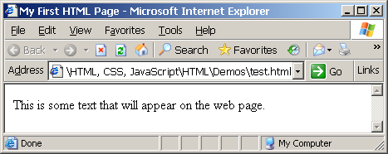
First HTML Page
test.html
<html>
<head>
<title>My First HTML Page</title>
</head>
<body>
<p>This is some text...</p>
</body>
</html>

Slide 33
HTML Structure
HTML is comprised of “elements” and “tags”
Begins with <html> and ends with </html>
Elements (tags) are nested one inside another:
Tags have attributes:
HTML describes structure using two main sections: <head> and <body>
<html> <head></head> <body></body> </html>
<img src="logo.jpg" alt="logo" />

Slide 34
HTML Code Formatting
The HTML source code should be formatted to increase readability and facilitate debugging.
Every block element should start on a new line.
Every nested (block) element should be indented.
Browsers ignore multiple whitespaces in the page source, so formatting is harmless.
For performance reasons, formatting can be sacrificed

Slide 35
First HTML Page: Tags
<!DOCTYPE HTML>
<html>
<head>
<title>My First HTML Page</title>
</head>
<body>
<p>This is some text...</p>
</body>
</html>
Opening tag
Closing tag
An HTML element consists of an opening tag, a closing tag and the content inside.

Slide 36
First HTML Page: Header
HTML header
<!DOCTYPE HTML>
<html>
<head>
<title>My First HTML Page</title>
</head>
<body>
<p>This is some text...</p>
</body>
</html>

Slide 37
First HTML Page: Body
<!DOCTYPE HTML>
<html>
<head>
<title>My First HTML Page</title>
</head>
<body>
<p>This is some text...</p>
</body>
</html>
HTML body

Slide 38
First HTML Page
test.html
<!DOCTYPE HTML>
<html>
<head>
<title>My First HTML Page</title>
</head>
<body>
<p>This is some text...</p>
</body>
</html>

Slide 39
Basic HTML Tags
Headings
Paragraph
Colors
Fonts
List
Anchor Tag
Image
Table
Form

Slide 40
1) Headings
Headings are important because search engines use the headings to index the structure and content of your web pages.
<h1> text </h1> -- largest of the six
<h2> text </h2>
<h3> text </h3>
<h4> text </h4>
<h5> text </h5>
<h6> text </h6> -- smallest of the six
align="position" --left (default), center or right

Slide 41
2) <p> paragraph
<p> defines a paragraph
Add align="position" (left, center, right)
Multiple <p>'s do not create blank lines
Use <br> for blank line
Fully-specified text uses <p> and </p>, but </p> is optional

Slide 42
3) Colors
Values for bgcolor and color
many are predefined (red, blue, green, ...)
all colors can be specified as a six character hexadecimal value: #RRGGBB
#FF0000 – red
#888888 – gray
#00FF00 –green
#000000 – black

Slide 43
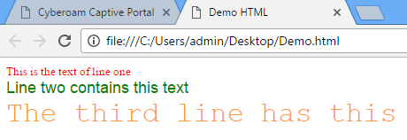
4) Fonts
The <font> tag specifies the font face, font size, and color of text.
The <font> tag is not supported in HTML5.
<font color="red" size="2" face="Times Roman">
This is the text of line one </font>
<font color="green" size="4" face="Arial">
Line two contains this text </font>
<font color="#FF9933" size="6" face="Courier“>
The third line has this additional text </font>

Slide 44
5) List
Ordered List
Block-A
Block-B
Block-C
Block-D
Unordered List
Block-A
Block-B
Block-C
Block-D
Block-A
Block-B
Block-C
Block-D
Block-A
Block-B
Block-C
Block-D
Block-A
Block-B
Block-C
Block-D
Block-A
Block-B
Block-C
Block-D
Block-A
Block-B
Block-C
Block-D
Block-A
Block-B
Block-C
Block-D

Slide 45
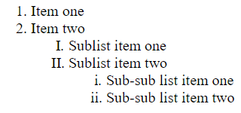
5.1) Ordered List
<ol>
<li> Item one </li>
<li> Item two </li>
<ol type="I" >
<li> Sublist item one </li>
<li> Sublist item two </li>
<ol type="i">
<li> Sub-sub list item one </li>
<li> Sub-sub list item two </li>
</ol>
</ol>
</ol>
Types:
Type = 1 (default)
Type = a
Type = A
Type = I
Type = i
Output

Slide 46
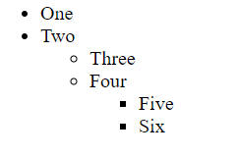
5.2) Unordered List
<ul>
<li> One </li>
<li> Two </li>
<ul type="circle">
<li> Three </li>
<li> Four </li>
<ul type="square">
<li> Five </li>
<li> Six </li>
</ul>
</ul>
</ul>
Types:
Type = disc (default)
Type = circle
Type = square
Output

Slide 47
6) <a> Anchor Tag (Hyperlinks)
The <a> tag defines a hyperlink, which is used to link from one page to another.
Link to an absolute URL:
If you get spam, contact <a href="http://www.microsoft.com">
Microsoft </a> to report the problem.
Link to a relative URL:
See these <a href=“./index.php"> references </a>
concerning our fine products.
Link to a section within a URL:
<a href=“#reference">
Reference Section. </a>

Slide 48
7) Images
Syntax :
<img src=“PathToImage”/>
src is required
alt will specify the text to display if the Image not found
width, height may be in units of pixels or percentage of page or frame
width="357"
height="50%“

Slide 49
Images (cont.)
<img src="dolphin.jpg" align="left" width="150" height="150" alt="dolphin jump!">
align=position | Image/Text Placement
Left | Image on left edge; text flows to right of image
Right | Image on right edge; text flows to left
Top | Image is left; words align with top of image
Bottom | Image is left; words align with bottom of image
Middle | Words align with middle of image

Slide 50
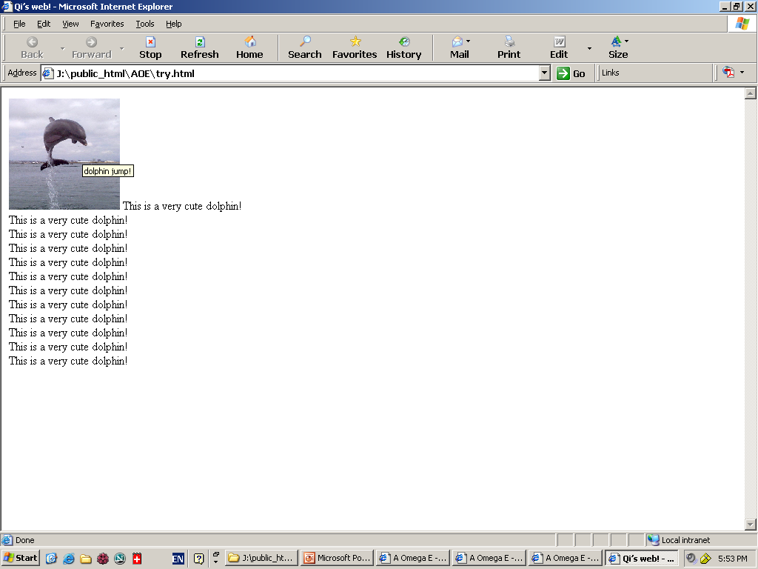
Image (cont.) => align=“bottom”

Slide 51
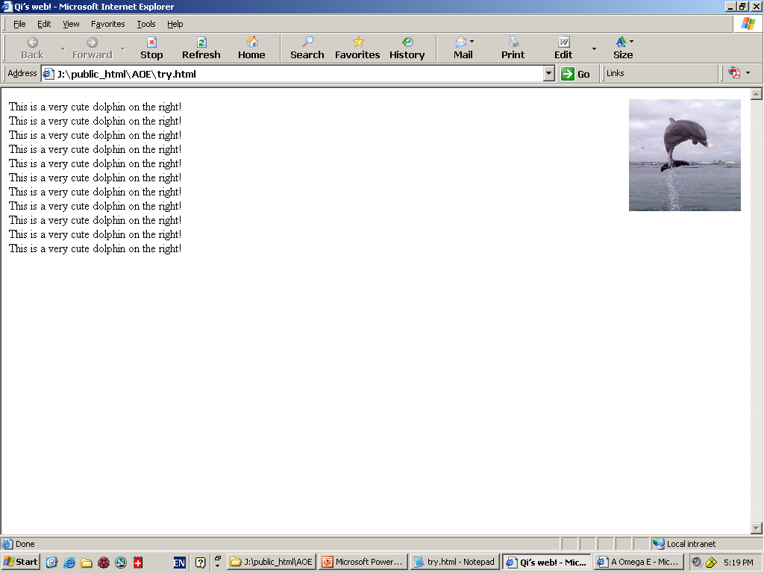
Image (cont.) => align=“right”

Slide 52
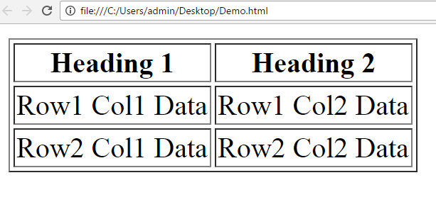
8) Table
<table> table tag
<caption> optional table title
<tr> table row
<th> table column header
<td> table data element
<table border=1>
<caption>Table Caption</caption>
<tr>
<th>Heading1</th>
<th>Heading2</th>
</tr>
<tr>
<td>Row1 Col1 Data</td>
<td>Row1 Col2 Data</td>
</tr>
<tr>
<td>Row2 Col1 Data</td>
<td>Row2 Col2 Data</td>
</tr>
</table>

Slide 53
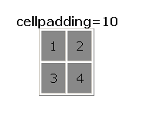
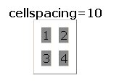
Table Element Attributes
align=position -- left, center, right for table
border=number -- width in pixels of border (default 0)
cellspacing=number -- spacing in pixels between cells, default about 3
cellpadding=number -- space in pixels between cell border and table element, default about 1
width=number[%]-- width in pixels or percentage of page/frame width

Slide 54
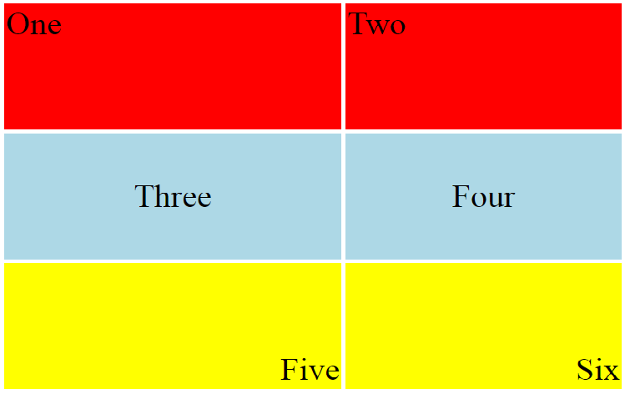
Table Row <tr> Attributes
Valid for the table row:
align -- left, center, right
valign -- top, middle, bottom
bgcolor -- background color
<table align="center" width="300" height="200">
<tr align="left" valign="top" bgcolor="red">
<td>One</td>
<td>Two</td>
</tr>
<tr align="center" valign="middle" bgcolor="lightblue">
<td>Three</td>
<td>Four</td>
</tr>
<tr align="right" valign="bottom" bgcolor="yellow">
<td>Five</td>
<td>Six</td>
</tr>
</table>

Slide 55
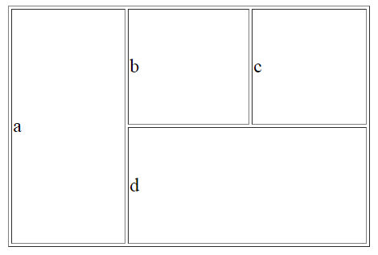
Irregular Table
a
b
c
Valid for the table cell:
colspan
- how many columns this cell occupies
rowspan
- how many rows this cell occupies
<table align="center" width="300" height="200" border="1">
<tr>
<td colspan="1" rowspan="2">a</td>
<td colspan="1" rowspan="1">b</td>
<td colspan="1" rowspan="1" >c</td>
</tr>
<tr>
<td colspan=“2" rowspan="1">d</td>
</tr>
</table>
d

Slide 56
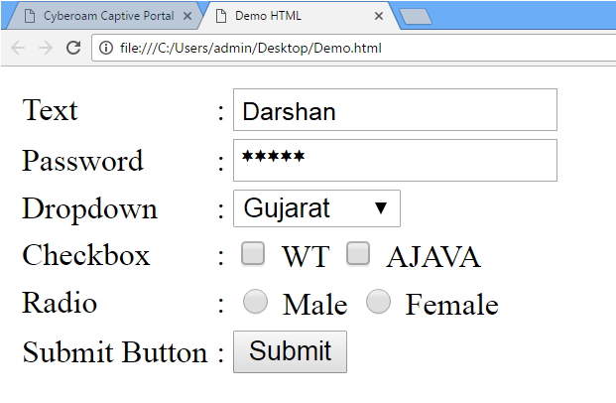
9) HTML Form
<form> is just another kind of HTML tag
HTML forms are used to create GUIs on Web pages
Usually the purpose is to ask the user for information
The information is then sent back to the server
A form is an area that can contain form elements
The syntax is: <form parameters> ...form elements... </form>
Form elements include: buttons, checkboxes, text fields, radio buttons, drop-down menus, etc
Other kinds of HTML tags can be mixed in with the form elements
A form usually contains a Submit button to send the information in the form elements to the server
The form’s parameters tell browser how to send the information to the server (there are two different ways it could be sent)

Slide 57
The <form> Tag
The <form arguments> ... </form> tag encloses form elements (and probably other HTML as well)
The arguments to form tell what to do with the user input
action="url" (required)
Specifies where to send the data when the Submit button is clicked
method="get" (default)
Form data is sent as a URL with ?form_data info appended to the end
Can be used only if data is all ASCII and not more than 100 characters
method="post"
Form data is sent in the body of the URL request
Cannot be bookmarked by most browsers
target="target"
Tells where to open the page sent as a result of the request
target= _blank means open in a new window
target= _top means use the same window

Slide 58




Input tags
Text field
Example: <input type=“text” name=“inputname”/>
Password field
Example: <input type=“password” name=“inputname”/>
Radio buttons
Example:
<input type="radio" name="gender"> Male
<input type="radio" name="gender"> Female
Check boxes
Example:
<input type="checkbox" name="Roll1"> Roll No 1 <br/>
<input type="checkbox" name="Roll2"> Roll No 2 <br/>
<input type="checkbox" name="Roll3"> Roll No 3 <br/>

Slide 59
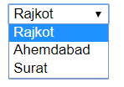
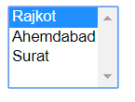
Input tags (cont.)
Dropdown list
<select> tag is used to create a drop-down list in HTML.
<option> tags inside the <select> tag define the available options in the list.
Example:
<select>
<option value=“1”>Rajkot</option>
<option value=“2”>Ahemdabad</option>
<option value=“3”>Surat</option>
</select>
Example (multiple select):
<select multiple="multiple">
<option value=“1”>Rajkot</option>
<option value=“2”>Ahemdabad</option>
<option value=“3”>Surat</option>
</select>

Slide 60
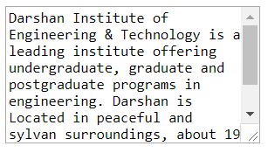

Input tags (cont.)
Text area
<textarea> tag defines a multi-line text
input control.
Example :
<textarea rows=“8” cols=“30”>
Darshan Institute of Engineering & Technology is a leading institute ….
</textarea>
Submit Button
Submit button is used to submit the data
to the form action url.
Example :
<input type=“submit” value=“Add City”>

Slide 61
XHTML
Prof. Arjun Bala
9624822202
arjun.bala@darshan.ac.in
Web Technology
2160708
Semester 6

Slide 62
Introduction to XHTML
Problems were initially caused in the development of HTML by a lack of standards.
Browser makers tended to add proprietary extensions that limited those who could see the sites in the way that was intended .
This was been termed the “browser wars” of 1990s.
The World Wide Web Consortium (W3C) became the main source for standards that browsers were to follow.

Slide 63
Introduction to XHTML (Cont.)
The evolution of HTML led to the separation of formatting instructions from content, leading to the development of CSS.
HTML was redeveloped as XHTML, using XML to apply more strict approach to web coding.
XHTML provides a more stable platform for CSS

Slide 64
XHTML
XHTML stands for EXtensible HyperText Markup Language
XHTML is almost identical to HTML 4.01
XHTML is a stricter and cleaner version of HTML 4.01
XHTML is HTML defined as an XML application
XHTML is supported by all major browsers.

Slide 65
Characteristics of XHTML
DOCTYPE is mandatory
XML namespace attribute in <html> is mandatory
<html>, <head>, <title>, and <body> is mandatory
elements must be properly nested
elements must always be closed
elements must be in lower case
documents must have one root element
Attribute names must be in lower case
Attribute values must be quoted
Attribute abbreviation is forbidden

Slide 66
XHTML DOCTYPE
An XHTML document must have an XHTML DOCTYPE declaration.
XHTML 1.0 document type definitions are corresponds to four Dtds:
Strict
Basic
Transitional
Frameset
The most commonly used is the XHTML Transitional document.

Slide 67
XHTML DOCTYPE (Cont.)
This DTD contains all HTML elements and attributes, but does NOT INCLUDE presentational or deprecated elements (like font). Framesets are not allowed.
XHTML 1.0 Strict:
<!DOCTYPE html
PUBLIC "-//W3C//Dtd XHTML 1.0 Strict//EN"
"http://www.w3.org/tr/xhtml1/Dtd/xhtml1-strict.dtd">
XHTML 1.0 Transitional:
<!DOCTYPE html
PUBLIC "-//W3C//Dtd XHTML 1.0 Transitional//EN"
"http://www.w3.org/tr/xhtml1/Dtd/xhtml1-transitional.dtd">
XHTML 1.0 Basic:
<!DOCTYPE html
PUBLIC "-//W3C//Dtd XHTML 1.0 Basic//EN"
"http://www.w3.org/tr/xhtml1/Dtd/xhtml1-basic10.dtd">
XHTML 1.0 Frameset:
<!DOCTYPE html
PUBLIC "-//W3C//Dtd XHTML 1.0 Frameset//EN"
"http://www.w3.org/tr/xhtml1/Dtd/xhtml1-frameset.dtd">
This DTD contains all HTML elements and attributes, INCLUDING presentational and deprecated elements (like font). Framesets are not allowed.
This DTD is equal to XHTML 1.0 Strict, but allows you to add modules (for example to provide ruby support for East-Asian languages).
This DTD is equal to XHTML 4.01 Transitional, but allows the use of frameset content.

Slide 68
XHTML Document Structure
A basic XHTML document consists of the following main parts:
xml version
The DOCTYPE (Dtd)
html document root
xmlns attribute for the html element
head element with a child title element
body element

Slide 69
XHTML Document Structure (Ex.)
<?xml version="1.0" ?>
<!DOCTYPE HTML PUBLIC "-//W3C//Dtd XHTML 1.00 Strict//EN" "http://www.w3.org/tr/xhtml1/Dtd/xhtml1-strict.dtd">
<html xmlns="http://www.w3.org/1999/xhtml">
<head>
<title>Hello</title>
</head>
<body>
helloooooooo
</body>
</html>

Slide 70
META Tag
Metadata is data (information) about data.
The <meta> tag provides metadata about the HTML document.
Metadata will not be displayed on the page.
Meta elements are typically used to specify page description, keywords, author of the document, last modified and other metadata.
The metadata can be used by search engines (keywords), browsers (how to display content or reload page) or other web services.

Slide 71
Meta Tag Attributes
Attribute | Value | Description
Charset | Character_set | Specifies the character encoding for the HTML document
name | author description keywords robots expires | Specifies a name for the metadata
http-equiv | content-type default-style refresh | Provides an HTTP header for the information/value of the content attribute
content | text | Gives the value associated with the http-equiv or name attribute
scheme | format/URI USA/Europe | Not supported in HTML5. Specifies a scheme to be used to interpret the value of the content attribute

Slide 72
Character Entities
Character entities are used to display reserved characters in HTML.
Characters that are not present on your keyboard can also be replaced by entities.
Character | Character Entity | Description
 | &nbsp; | Space
& | &amp; | Ampersand
“ | &quot; | Quote
< | &lt; | Less than
> | &gt; | Greater than
© | &copy; | Copyright
® | &reg; | Registered
™ | &trade; | Trademark
£ | &pound; | Pound
¢ | &cent; | Cent
÷ | &divide; | Divide

Slide 73
How Browser Works ?
Keyboard and Mouse
Output
To
Display
Controller
HTML Interpreter
Display
Drivers
Plug-Ins/
Other Interpreter
Response from web server
Network Interface
Other Clients
HTTP Client
Communication with web server

Slide 74
Introduction to HTML 5
The DOCTYPE declaration for HTML5 is very simple:
<!DOCTYPE html>
The character encoding (charset) declaration is also very simple:
<meta charset="UTF-8">
New HTML5 Elements:
New semantic elements like <header>, <footer>, <article>, and <section>.
New form control attributes like number, date, time, calendar, and range.
New graphic elements: <svg> and <canvas>.
New multimedia elements: <audio> and <video>.
Some Elements Removed in HTML5

Slide 75
Introduction to HTML 5 (cont.)
The following HTML4 elements have been removed from HTML5:
HTML 4 | HTML 5
<acronym> | <abbr>
<applet> | <object>
<center> | CSS
<dir> | <ul>
<font> | CSS
HTML 4 | HTML 5
<strike> | CSS
<tt> | CSS
<basefont> | CSS
<big> | CSS

Slide 76
Unit – 3 Cascading Style Sheets (CSS)

Slide 77
Outline
Introduction to CSS
What is CSS?
Importance of CSS
Basics of CSS
Basic Syntax & Structure
Class & ID
Types of CSS
Multiple selector, Multilevel selector
Background
Fonts & Text

Slide 78
Outline (Cont.)
Box Model
Margin, Border, Padding
List
List Type, List with Image, List Position
Links
CSS Positioning
CSS Layers
CSS Floating Property
Introduction to CSS3

Slide 79
What is CSS?
Cascading Style Sheets, fondly referred to as CSS, is a simple design language intended to simplify the process of making web pages presentable.
CSS defines layout of HTML documents. For example, CSS covers Fonts, colors, margins, lines, height, width, background images, advanced positions and many other things.

Slide 80
Importance of CSS
CSS defines HOW HTML elements are to be displayed.
Styles are normally saved in external .css files.
External style sheets enable you to change the appearance and layout of all the pages in a Web site, just by editing one single file.
Advantages :
Improves Website Presentation
External CSS makes Updates Easier and Smoother
External CSS helps Web Pages Load Faster
Disadvantages :
Browser Dependent
Difficult to retrofit in old websites

Slide 81
Basic Syntax of CSS
A CSS rule has two main parts: a selector, and one or more declarations
The selector can be HTML element, id or class.
Each declaration consists of a property and a value.
The property is the style attribute you want to change. Each property has a value.
Selector
Declaration 1
Declaration 2
h1
{color: blue; font-size: 12px;}
property
value
property
value

Slide 82
The “id” selector
The id selector is used to specify a style for a single, unique element.
The id selector uses the id attribute of the HTML element, and is defined with a "#“ in css.
The style rule below will be applied to the element with id="para1":
HTML
<h1 id=“para1”>
Hello Friends
</h1>
<h1>
How are you
</h1>
CSS
#para1{
color: blue;
}
Output
Hello Friends
How are you

Slide 83
The “class” selector
The class selector is used to specify a style for a group of elements.
The class selector uses the HTML class attribute, and is defined with a ".“ in css.
HTML
<h1 class=“myClass”>
Hello Friends
</h1>
<h1>
How are you
</h1>
<h1 class=“myClass”>
How are you
</h1>
CSS
.myClass{
color: blue;
}
Output
Hello Friends
How are you
How are you

Slide 84
Different ways to write CSS
There are three ways of writing a style sheet:
Inline Style
Internal/Embedded Style sheet
External Style Sheet

Slide 85
1) Inline Style
It is possible to place CSS right in your HTML code, and this method of CSS usage is referred to as inline css.
Inline CSS has the highest priority out of external, internal, and inline CSS.
This means that you can override styles that are defined in external or internal by using inline CSS.
If you want to add a style inside an HTML element all you have to do is specify the desired CSS properties with the style HTML attribute.
Example:
HTML
<p style="background: blue; color: white;"> My Inline CSS </p>

Slide 86
2) Internal Style Sheet
This type of CSS is only for Single Web Page.
When using internal CSS, we must add a new tag, <style>, inside the <head> tag.
The HTML code below contains an example of <style>'s usage.
HTML
<html><head>
<style type="text/css">
p{ color: red;}
</style>
</head><body>
<p>Your page's content!</p></body>
</html>

Slide 87
3) External Style Sheet
When using CSS it is preferable to keep the CSS separate from your HTML.
Placing CSS in a separate file allows the web designer to completely differentiate between content (HTML) and design (CSS).
External CSS is a file that contains only CSS code and is saved with a ".css" file extension.
This CSS file is then referenced in your HTML using the <link> instead of <style>.

Slide 88
3) External Style Sheet (Cont.)
Example :
Demo.html
<html>
<head>
<link rel=“stylesheet” type=“text/css” href=“test.css”>
</head>
<body>
<p> Hello Friends </p>
<p id=“para1”> How are you? </p>
</body>
</html>
test.css
#para1{
text-align: center;
}
p
{
color : blue;
}
Output
Hello Friends
How are you?

Slide 89
3) External Style Sheet (Cont.)
Advantages:
It keeps your website design and content separate.
It's much easier to reuse your CSS code if you have it in a separate file. Instead of typing the same CSS code on every web page you have, simply have many pages refer to a single CSS file with the "link" tag.
You can make drastic changes to your web pages with just a few changes in a single CSS file.

Slide 90
Assign Multiple Classes
We can apply different class to same html element by giving space separated class names in the class attribute:
Demo.html
<html>
<head>
<link rel=“stylesheet” type=“text/css” href=“test.css”>
</head>
<body>
<h1 class=“class1 class2”>
How are you?
</h1>
</body>
</html>
test.css
. class1
{
color : blue;
}
. class2
{
text-align : center;
}
Output
How are you?

Slide 91
Multiple Selection
We can apply same css to multiple selectors using comma separated selector list, for example :
Demo.html
<html>
<head>
<link rel=“stylesheet” type=“text/css” href=“test.css”>
</head>
<body>
<p> Hello Friends </p>
<h1> How are you? </h1>
</body>
</html>
test.css
p, h1
{
color : blue;
}
Output
Hello Friends
How are you?

Slide 92
Multi-level Selection
We can use hierarchical path to target html element by space separated element/class/id names, for example :
Demo.html
<html>
<head>
<link rel=“stylesheet” type=“text/css” href=“test.css”>
</head>
<body>
<h1>Hello Friends…</h1>
<div>
<h1>How are you?</h1>
</div>
</body>
</html>
test.css
div h1
{
color : blue;
}
Output
Hello Friends…
How are you?

Slide 93
Background Property
Property Name
Background Color (background-color)
Background Image (background-image)
Background Image Repeat (background-repeat)
Fixed Background Image (background-attachment)
Background Image Positioning (background-position)

Slide 94
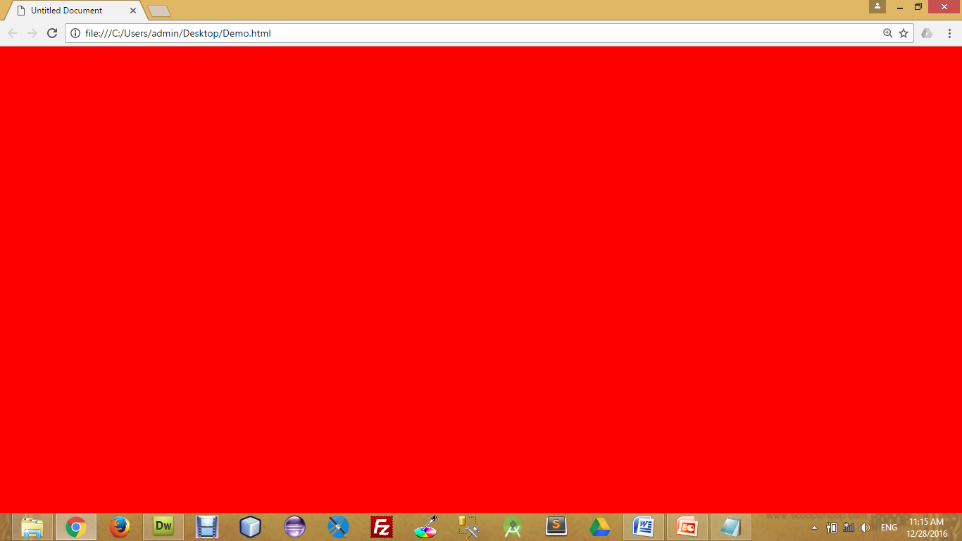
Background Color
The background-color property specifies the background color of an element.
The background color of a page is defined in the body selector:
Below is example of CSS backgrounds
test.css
body
{
background-color : red;
background-color : #FF0000;
background-color : rgb(255,0,0);
}

Slide 95
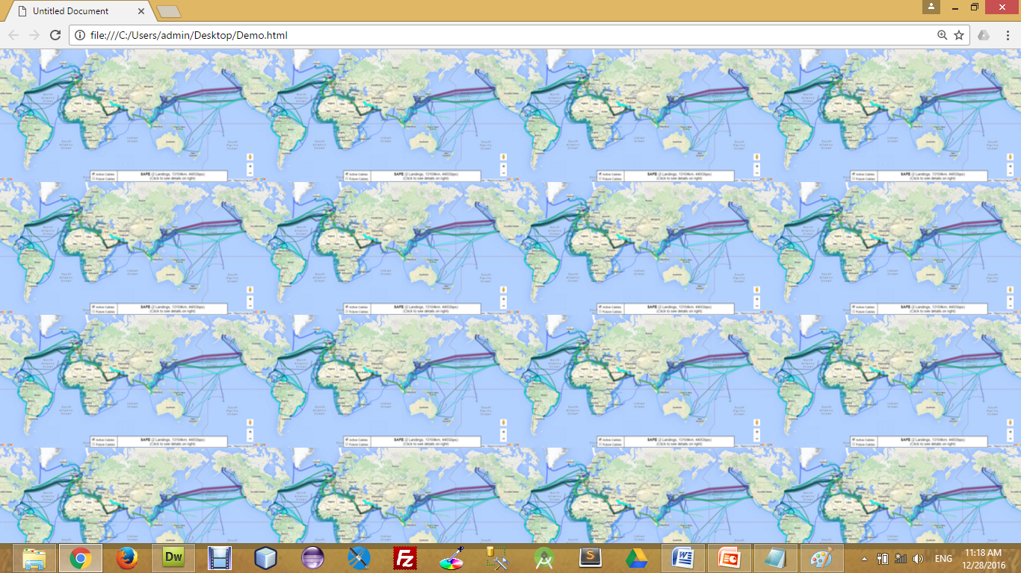

Background Image
The background-image property specifies an image to use as the background of an element.
For Example,
test.css
body
{
background-image : url(‘pathToImage.jpg’);
}

Slide 96
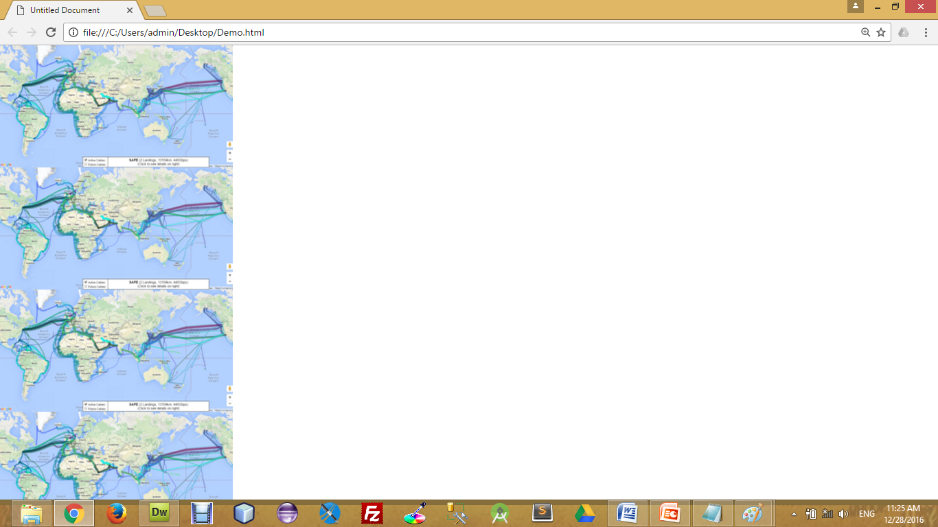
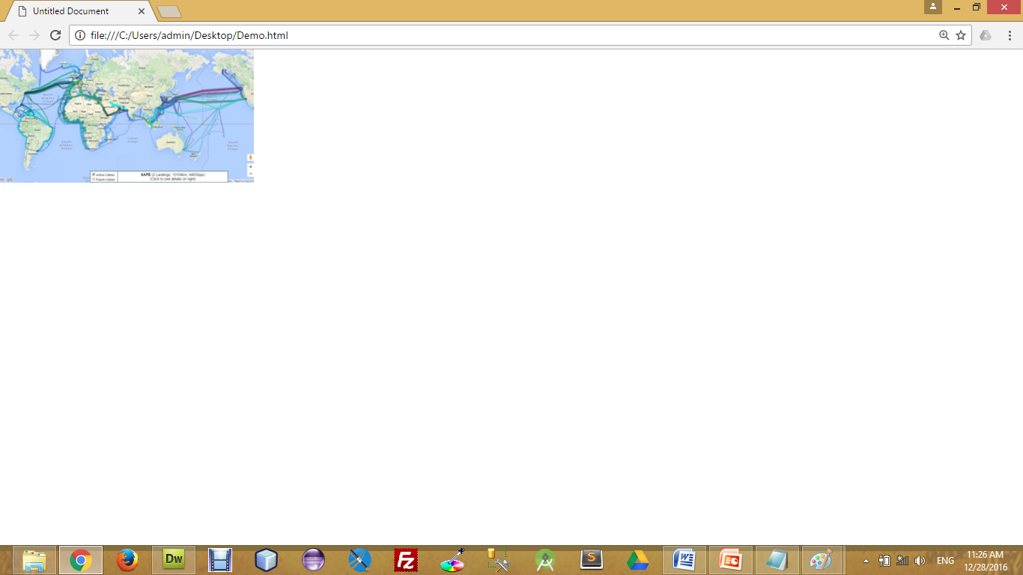
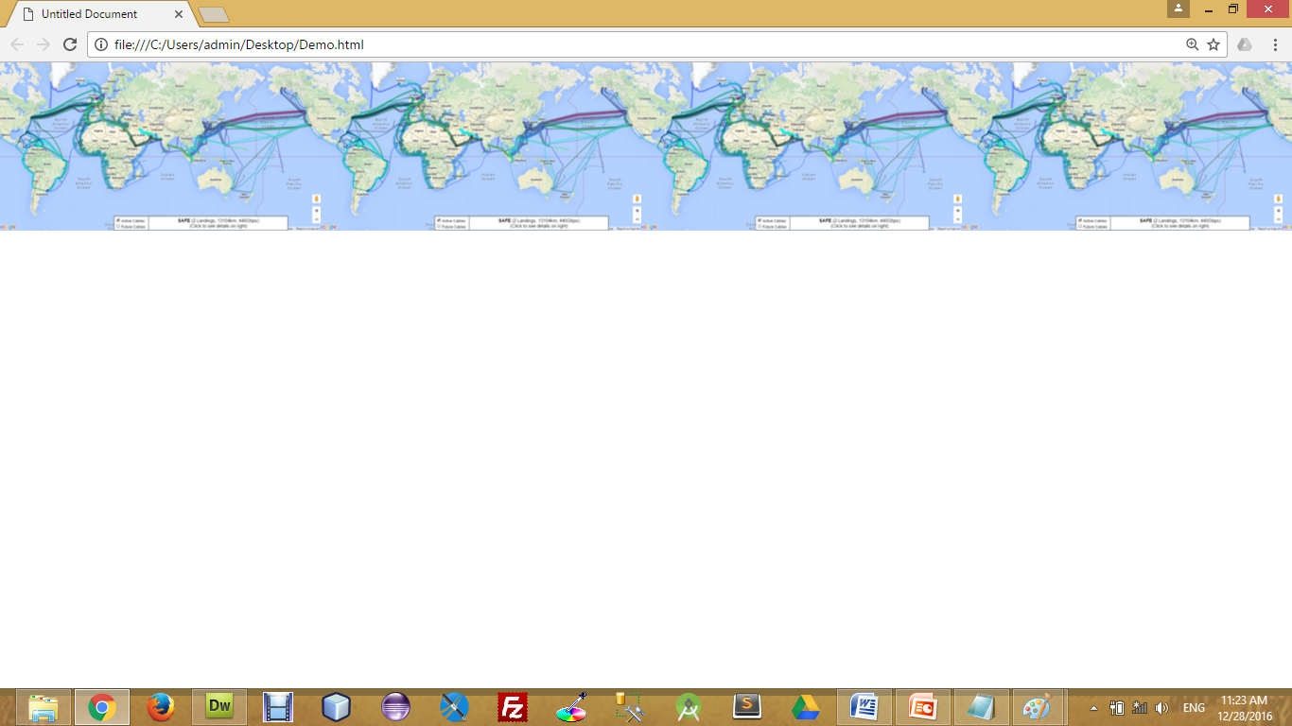
Background Image Repeat
You can have a background image repeat vertically (y-axis), horizontally (x-axis), in both directions, or in neither direction.
test.css
body
{
background-image : url(‘pathToImage.jpg’);
background-repeat : repeat;
background-repeat : repeat-x;
background-repeat : repeat-y;
background-repeat : no-repeat;
}
no-repeat
repeat-y
repeat-x

Slide 97
Fixed Background Image
The background-attachment property sets whether a background image is fixed or scrolls with the rest of the page.
For Example,
test.css
body
{
background-image : url(‘pathToImage.jpg’);
background-repeat : no-repeat;
background-attachment : fixed;
}

Slide 98
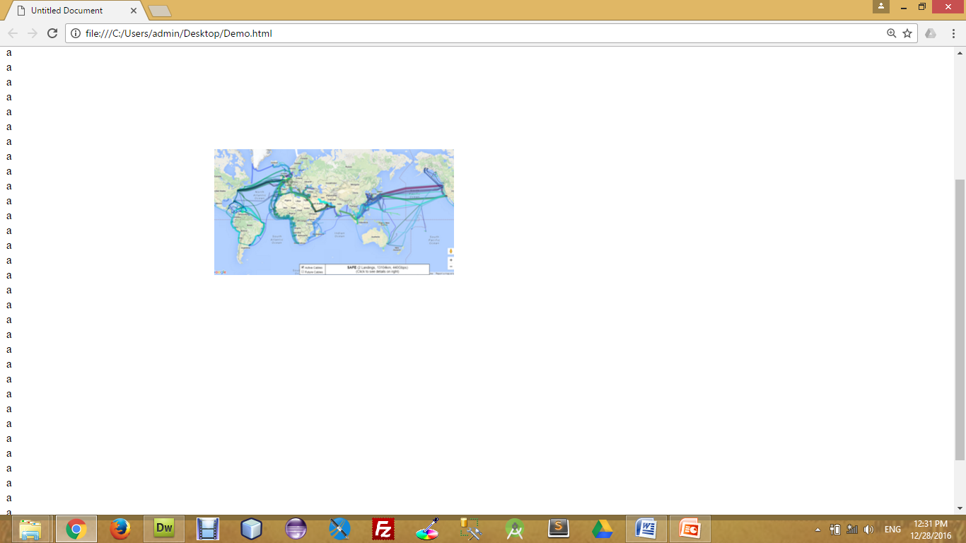
Background Image Positioning
The background-position property sets the starting position of a background image.
test.css
body
{
background-image : url(‘pathToImage.jpg’);
background-repeat : no-repeat;
background-position: 20px 10px;
background-position: 30%30%;
background-position: top center;
}
30% 30%

Slide 99
CSS Font
CSS font properties define the font family, boldness, size, and the style of a text.
Font Color (color)
Font Family (font-family)
Font Size (font-size)
Font Style (font-style)
Font Weight (font-weight)
Font Variant (font-variant)
Property Name

Slide 100
CSS Font (Cont.)
Font Color
Set the text-color for different elements
Font Family
The font family of a text is set with the font-family property.
Font Size
The font-size property sets the size of the text.
font-size : 120%
font-size : 10px;
font-size : x-large;
h4{
color : red;
}
h4{
font-family : sans-serif;
}
h4{
font-size: 120%;
font-size : 10px;
font-size : small;
font-size : smaller;
font-size : x-small;
font-size : xx-small;
font-size : large;
font-size : larger;
font-size : x-large;
font-size : xx-large;
font-size : medium;
}

Slide 101
CSS Font (Cont.)
Font Style
The font-style property is mostly used to specify italic text.
Font Weight
The font-weight property sets how thick or thin characters in text should be displayed.
Font Variant
The font-variant property specifies whether or not a text should be displayed in a small-caps font.
font-variant : small-caps;
h4{
font-style: italic ;
}
h4{
font-weight : 300;
font-weight : bolder;
font-weight : lighter;
}
h4{
font-variant: small-caps;
}

Slide 102
CSS Text Property
While CSS Font covers most of the traditional ways to format your text, CSS Text allows you to control the spacing, decoration, and alignment of your text.
Text Decoration (text-decoration)
Text Indent (text-indent)
Text Align (text-align)
Text Transform (text-transform)
White Space (white-space)
Word Spacing (word-spacing)
Letter Spacing (letter-spacing)
Line Height (line-height)
Property Name

Slide 103
CSS Text Property (Cont.)
Text Decoration
The text-decoration property is used to set or remove decorations from text.
The text-decoration property is mostly used to remove underlines from links for design purposes.
Text Indent
The text-indentation property is used to specify the indentation of the first line of a text.
Text Align
The text-align property is used to set the horizontal alignment of a text.
h4{
text-decoration : line-through;
text-decoration : overline;
text-decoration : underline;
text-decoration : none;
}
h4{
text-indent : 20px;
text-indent : 30%;
}
h4{
text-align : right;
text-align : justify;
text-align : left;
text-align : center;
}

Slide 104
CSS Text Property (Cont.)
Text Transform
The text-transform property is used to specify uppercase and lowercase letters in a text.
White Space
The white-space attribute allows you to prevent text from wrapping until you place a break <br /> into your text.
Word Spacing
With the CSS attribute word-spacing you are able to specify the exact value of the spacing between your words. Word-spacing should be defined with exact values.
h4{
text-transform : capitalize;
text-transform : uppercase;
text-transform : lowercase;
}
h4{
white-space : nowrap;
}
h4{
word-spacing : 10px;
}

Slide 105
CSS Text Property (Cont.)
Letter Spacing
With the CSS attribute letter-spacing you are able to specify the exact value of the spacing between your letters. Letter-spacing should be defined with exact values.
Line Height
The line-height attribute will set the height of the line in the page.
h4{
letter-spacing : 3px;
}
h4{
line-height : 10px;
}

Slide 106
The Box Model
All HTML elements can be considered as boxes. In CSS, the term "box model" is used when talking about design and layout.
The CSS box model is essentially a box that wraps around HTML elements, and it consists of: margins, borders, padding, and the actual content.
The box model allows us to place a border around elements and space elements in relation to other elements.

Slide 107
The Box Model (Cont.)
The image below illustrates the box model:
Margin
Border
Padding
Content

Slide 108
The Box Model (Cont)
margin-top
border-top
padding-top
Content
border-right
padding-left
margin-right
margin-left
padding-right
border-left
padding-bottom
border-bottom
margin-bottom

Slide 109
CSS Padding
The CSS padding properties define the space between the element border and the element content.
The top, right, bottom, and left padding can be changed independently using separate properties.
A shorthand padding property can also be used, to change all padding at once.
h4{
padding : 10px;
}
h4{
padding-top : 10px;
padding-right : 20px;
padding-bottom : 30 px;
padding-left : 40 px;
}
h4{
padding : 10px 20px 30px 40px;
}

Slide 110
CSS Border
The CSS border properties allow you to specify the style and color of an element's border.
Border Style Types
The border-style property specifies what kind of border to display.
Border Width
The border-width property is used to set the width of the border.
Border Color
The border-color property is used to set the color of the border.
Border colors can be any color defined by RGB, hexadecimal, or key terms. Below is an example of each of these types.
The top, right, bottom, and left border can be changed independently using separate properties.
h4{
border : 1px solid red;
}
h4{
border-style : solid;
border-style : dotted;
border-style : double;
}
h4{
border-width : 7px;
}
h4{
border-color : red;
}
h4{
border-top : 1px solid red;
}

Slide 111
CSS Margin
The CSS margin properties define the space around elements
The top, right, bottom, and left margin can be changed independently using separate properties.
A shorthand margin property can also be used, to change all margins at once.
h4{
margin: 10px;
}
h4{
margin -top : 10px;
margin -right : 20px;
margin -bottom : 30 px;
margin -left : 40 px;
}
h4{
margin : 10px 20px 30px 40px;
}

Slide 112
CSS List
ul{
list-style-type: circle;
list-style-type: disc;
list-style-type: square;
list-style-type: armenian;
list-style-type: cjk-ideographic;
list-style-type: decimal-leading-zero;
list-style-type: georgian;
list-style-type: hebrew;
list-style-type: katakana;
list-style-type: lower-greek; }
The CSS list properties allow you to:
Set different list item markers for ordered & unordered lists
Set an image as the list item marker
Set the position of the marker
CSS List Style Type
CSS List with Image
CSS List Position
ol{
list-style-image : url(‘imgPath’);
}
ol{
list-style-position : outside;
list-style-position : inside;
}

Slide 113
Styling Links
Anchor/Link States
The four links states are:
a:link - a normal, unvisited link
a:visited - a link the user has visited
a:hover - a link when the user mouse over it
a:active - a link the moment it is clicked
a:link{
color:#FF0000; /*unvisited link*/
}
a:visited{
text-decoration : none; /*visited link*/
}
a:hover{
color:#00FF00; /*mouse over link*/
}
a:active{
color:#0000FF; /*selected link*/
}

Slide 114
CSS Positioning
Absolute Positioning
With absolute positioning, you define the exact pixel value where the specified HTML element will appear.
The point of origin is the top-left of the browser's viewable area, so be sure you are measuring from that point.
Relative Positioning
Relative positioning changes the position of the HTML element relative to where it normally appears.
Fixed Positioning
The element is positioned relative to the browser window, in fixed position, element will be in the same place even we scroll the screen.
h1{
position : absolute;
left : 50px;
top : 100px;
}
h1{
position : relative;
left : 50px;
top : 100px;
}
h1{
position : fixed;
top : 50px;
left : 100px;
}

Slide 115

CSS Layers
CSS allows you to control which item will appear on top with the use of layers.
In CSS, each element is given a priority.
If there are two overlapping CSS positioned elements, the element with the higher priority will appear on top of the other.
To manually define a priority, set the z-index value. The larger the value, the higher the priority the element will have.
CSS
#division1{
position : absolute;
height : 100px;
width : 100px;
left : 100px;
top : 150px;
background-color : red;
z-index : 5;
}
#division2{
position : absolute;
height : 200px;
width : 200px;
left : 50px;
top : 100px;
background-color : blue;
z-index : 2;
}
HTML
<div id="division1">
</div>
<div id="division2">
</div>

Slide 116
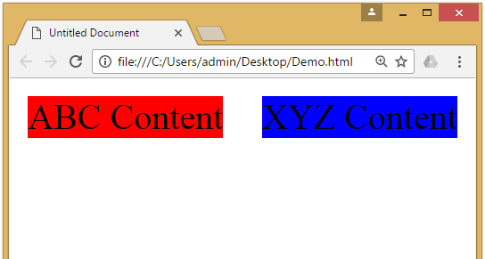
CSS Float Property
The CSS float property defines that an element should be taken out of the normal flow of the document and placed along the left or right side of its containing block.
Text and inline elements will then wrap around this element.
CSS
#division1{
background-color : red;
float : left;
width: 40%;
}
#division2{
background-color : blue;
float : right;
width: 40%;
}
HTML
<div id="division1">
ABC Content
</div>
<div id="division2">
XYZ Content
</div>

Slide 117
Introduction to CSS3
CSS3 is the latest standard for CSS.
CSS3 is completely backwards-compatible with earlier versions of CSS.
CSS3 has been split into "modules". It contains the "old CSS specification" (which has been split into smaller pieces). In addition, new modules are added.
CSS3 Transitions are a presentational effect which allow property changes in CSS values, such as those that may be defined to occur on :hover or :focus, to occur smoothly over a specified duration – rather than happening instantaneously as is the normal behaviour.
Transition effects can be applied to a wide variety of CSS properties, including background-color, width, height, opacity, and many more.

Slide 118
Introduction to CSS3 (Cont)
Some of the most important CSS3 modules are:
CSS Animations and Transitions
Calculating Values With calc()
Advanced Selectors
Generated Content and Counters
Gradients
Webfonts
Box Sizing
Border Images
Media Queries
Multiple Backgrounds
CSS Columns
Courtesy : http://tutorialzine.com/2013/10/12-awesome-css3-features-you-can-finally-use/

Slide 119
Unit-4
Java Script (JS)

Slide 120
Outline
Introduction
Task Performed by Client side Scripts
Pros & Cons of Client side Scripts
Client side Scripts V/S Server side Scripts
Variables
Functions
Conditions & Loops
Pop up boxes
External JavaScript
JavaScript Objects
DOM
DHTML

Slide 121
Introduction
For a Web page, HTML supplies document content and structure while CSS provides presentation styling
In addition, client-side scripts can control browser actions associated with a Web page.
Client-side scripts are almost written in the Javascript language to control browser’s actions.
Client-side scripting can make Web pages more dynamic and more responsive

Slide 122
Tasks performed by client-side scripts
Checking correctness of user input
Monitoring user events and specifying reactions
Replacing and updating parts of a page
Changing the style and position of displayed elements dynamically
Modifying a page in response to events
Getting browser information
Making the Web page different depending on the browser and browser features
Generating HTML code for parts of the page

Slide 123
Pros & Cons of Client Side Scripting
Pros
Allow for more interactivity by immediately responding to users’ actions.
Execute quickly because they do not require a trip to the server.
The web browser uses its own resources, and eases the burden on the server.
It saves network bandwidth.
Cons
Code is loaded in the browser so it will be visible to the client.
Code is modifiable.
Local files and databases cannot be accessed.
User is able to disable client side scripting

Slide 124
Client V/S Server Side Scripting
Server Side Scripting | Client Side Scripting
Server side scripting is used to create dynamic pages based on a number of conditions when the users browser makes a request to the server. | Client side scripting is used when the users browser already has all the code and the page is altered on the basis of the users input.
The Web Server executes the server side scripting that produces the page to be sent to the browser. | The Web Browser executes the client side scripting that resides at the user’s computer.
Server side scripting is used to connect to the databases and files that reside on the web server. | Client side scripting cannot be used to connect to the databases and files on the web server.

Slide 125
Client V/S Server Side Scripting (Cont)
Server Side Scripting | Client Side Scripting
Server resources can be accessed by the server side scripting. | Browser resources can be accessed by the client side scripting.
Server side scripting can’t be blocked by the user. | Client side scripting is possible to be blocked by the user.
Examples of Server side scripting languages : PHP, JSP, ASP, ASP.Net, Ruby, Perl and many more. | Examples of Client side scripting languages : Javascript, VB script, etc.
0

Slide 126
<script> tag
The <script> tag is used to define a client-side script (JavaScript).
The <script> element either contains scripting statements, or it points to an external script file through the src attribute.
Example :
Code
<html>
<head>
<title>HTML script Tag</title>
</head>
<body>
<script type="text/javascript">
// Java Script Code Here
</script>
</body>
</html>
Code
<html>
<head>
<title>HTML script Tag</title>
</head>
<body>
<script src=“PathToJS”>
</script>
</body>
</html>

Slide 127
Variables
A variable can contain several types of value:
Number : a numeric value e.g. 156, 100, 1.2
String : character wrapped in quotes e.g. “rajkot”
Boolean : a value of true or false
Null : an empty variable
Function : a function name
Object : an object
Attributes of Javascript variables :
It is a case sensitive. (mynum and MyNum are different variables)
It cannot contain punctuation, space or start with a digit
It cannot be a JavaScript reserved word

Slide 128
Conditions
If condition
if(a>10)
{
alert(“A is > that 10”);
}
switch
switch(expression)
{
case lbl1:
// code to execute
break;
case lbl2:
// code to execute
break;
}
ternary operator
max = a>b ? a : b ;

Slide 129
Loops
for loop
Use when you know how many repetitions you want to do
syntax
for(initialize ; condition ; increment) { … }
example
for(x=0;x<10;x++) {
// Code Here
}
while loop
Loops through block of code while condition is true
syntax
while(condition) { … }
example
while (x<10) {
//Code Here
}
do while loop
Execute block at least once then repeat while condition is true
syntax
do{ … } while (condition);
example
do{
// Code Here
} while (x<10)

Slide 130
Strings
A string can be defined as a sequence of letters, digits, punctuation and so on.
A string in a JavaScript is wrapped with single or double quotes
Strings can be joined together with the + operator, which is called concatenation.
For Example,
mystring = “my college name is ” + “Darshan”;
As string is an object type it also has some useful features.
For Example,
lenStr = mystring.length;
Which returns the length of the string in integer

Slide 131
Strings (Cont.)
There are also number of methods available for string.
Method | Description
charAt | Returns the character at a specific index
indexOf | Find the first index of a character
lastIndexOf | Find the last index of a character
substring / substr | Return a section of a string.
replace | Replaces a specified value with another value in a string
toLowerCase | Convert a string to lower case.
toUpperCase | Convert a string to upper case.

Slide 132
Strings (Cont.)
An escape sequence is a sequence of characters that does not represent itself when used inside a character or string, but is translated into another character or a sequence of characters that may be difficult or impossible to represent directly.
Some Useful Escape sequences :
Sequence | Character
\t | Tab
\n | Newline
\r | Carriage return
\” | Double Quote
\’ | Single Quote
\\ | Backslash

Slide 133
Arrays
An array is a collection of data, each item in array has an index to access it.
Ways to use array in JavaScript
var myArray = new Array();
myArray[0] = “darshan”;
myArray[1] = 222;
myArray[2] = false;
var myArray = new Array(“darshan” , 123 , true);

Slide 134
Functions
A JavaScript function is a block of code designed to perform a particular task.
A JavaScript function is executed when "something" invokes it.
A JavaScript function is defined with the function keyword, followed by a name, followed by parentheses ().
The parentheses may include parameter names separated by commas: (parameter1, parameter2, ...)
The code to be executed, by the function, is placed inside curly brackets.
Example :
Code
function myFunction(p1, p2) {
return p1 * p2;
}

Slide 135
Functions (Cont.)
When JavaScript reaches a return statement, the function will stop executing.
If the function was invoked from a statement, JavaScript will "return" to execute the code after the invoking statement.
The code inside the function will execute when "something" invokes (calls) the function:
When an event occurs (when a user clicks a button)
When it is invoked (called) from JavaScript code
Automatically (self invoked)

Slide 136
Pop up Boxes
Popup boxes can be used to raise an alert, or to get confirmation on any input or to have a kind of input from the users.
JavaScript supports three types of popup boxes.
Alert box
Confirm box
Prompt box

Slide 137
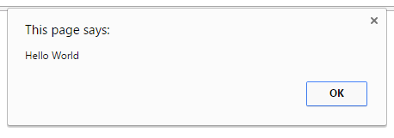
Alert Box
An alert box is used if you want to make sure information comes through to the user.
When an alert box pops up, the user will have to click "OK" to proceed.
It can be used to display the result of validation.
Code
<html>
<head>
<title>Alert Box</title>
</head>
<body>
<script>
alert("Hello World");
</script>
</body>
</html>

Slide 138
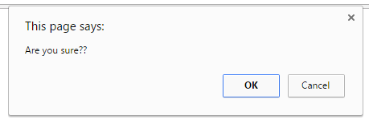
Confirm Box
A confirm box is used if you want the user to accept something.
When a confirm box pops up, the user will have to click either "OK" or "Cancel" to proceed, If the user clicks "OK", the box returns true. If the user clicks "Cancel", the box returns false.
Example :
Code
<script>
var a = confirm(“Are you sure??");
if(a==true) {
alert(“User Accepted”);
}
else {
alert(“User Cancled”);
}
</script>

Slide 139
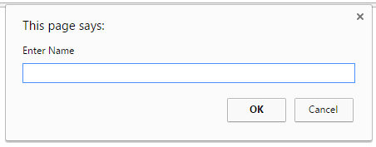
Prompt Box
A prompt box is used if you want the user to input a value.
When a prompt box pops up, user have to click either "OK" or "Cancel" to proceed, If the user clicks "OK" the box returns the input value, If the user clicks "Cancel" the box returns null.
Code
<script>
var a = prompt(“Enter Name");
alert(“User Entered ” + a);
</script>

Slide 140
External JavaScript
We can create external JavaScript file and embed it in many html pages.
It provides code reusability because single JavaScript file can be used in several html pages.
An external JavaScript file must be saved by .js extension.
To embed the External JavaScript File to HTML we can use script tag with src attribute in the head section to specify the path of JavaScript file.
For Example :
<script type="text/javascript" src="message.js"></script>

Slide 141
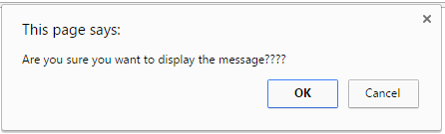
External JavaScript (Example)
message.js
function myAlert(msg) {
if(confirm("Are you sure you want to display the message????")) {
alert(msg);
}
else {
alert("Message not Displayed as User Cancled Operation");
}
}
myHtml.html
<html>
<head>
<script src=“message.js”></script>
</head>
<body>
<script> myAlert(“Hello World”); </script>
</body>
</html>

Slide 142
JavaScript Objects
An object is just a special kind of data, with properties and methods.
Accessing Object Properties
Properties are the values associated with an object.
The syntax for accessing the property of an object is below
objectName.propertyName
This example uses the length property of the Javascript’s inbuilt object(String) to find the length of a string:
var message="Hello World!"; var x=message.length;

Slide 143
JavaScript Objects (Cont.)
Accessing Object Methods
Methods are the actions that can be performed on objects.
You can call a method with the following syntax. objectName.methodName()
This example uses the toUpperCase method of the String object to convert string to upper case:
var message="Hello World!"; var x=message.toUpperCase();

Slide 144
JavaScript’s inbuilt Objects
JavaScript comes with some inbuilt objects which are,
String
Date
Array
Boolean
Math
RegExp
etc….

Slide 145
Math Object in JavaScript
The Math object allows you to perform mathematical tasks.
The Math object includes several mathematical constants and methods.
Example for using properties/methods of Math:
Code
<script>
var x=Math.PI; var y=Math.sqrt(16);
</script>

Slide 146
Math Object (Cont.)
Math object has some properties which are,
Properties | Description
E | Returns Euler's number(approx.2.718)
LN2 | Returns the natural logarithm of 2 (approx.0.693)
LN10 | Returns the natural logarithm of 10 (approx.2.302)
LOG2E | Returns the base‐2 logarithm of E (approx.1.442)
LOG10E | Returns the base‐10 logarithm of E (approx.0.434)
PI | Returns PI(approx.3.14)
SQRT1_2 | Returns square root of ½
SQRT2 | Returns square root of 2

Slide 147
Math Methods (Cont.)
Method | Description
abs(x) | Returns the absolute value of x
sin(x) | Returns the sine of x (x is in radians)
cos(x) | Returns the cosine of x (x is in radians)
tan(x) | Returns the tan of x (x is in radians)
acos(x) | Returns the arccosine of x, in radians
asin(x) | Returns the arcsine of x, in radians
atan(x) | Returns the arctangent of x as a numeric value
atan2(x) | Returns arctangent of x
random(x) | Returns random floating number between 0 to 1
Method | Description
exp(x) | Returns the value of Ex
ceil(x) | Returns x, rounded upwards to the nearest integer
floor(x) | Returns x, rounded downwards to the nearest integer
log(x) | Returns the natural logarithm(base E) of x
round(x) | Rounds x to the nearest integer
pow(x,y) | Returns the value of x to the power of y
max(x,y,z,...,n) | Returns the number with the highest value
sqrt(x) | Returns the square root of x

Slide 148
User Defined Objects
JavaScript allows you to create your own objects.
The first step is to use the new operator.
var myObj= new Object();
This creates an empty object.
This can then be used to start a new object that you can then give new properties and methods.
In object- oriented programming such a new object is usually given a constructor to initialize values when it is first created.

Slide 149
User - Defined Objects (Cont.)
However, it is also possible to assign values when it is made with literal values.
example
<script>
person={
firstname: "Darshan",
lastname: "College",
age: 50,
eyecolor: "blue"
}
alert(person.firstname + " is " + person.age + " years old.");
</script>

Slide 150
User - Defined Objects (Cont.)
A constructor is pre defined method that will initialize your object.
To do this in JavaScript a function is used that is invoked through the new operator.
Any properties inside the newly created object are assigned using this keyword, referring to the current object being created.
example
<script>
function person(firstname, lastname, age){
this.firstname = firstname;
this.lastname = lastname;
this. changeFirstName = function (name){ this.firstname = name };
}
var person1=new person("Narendra","Modi",50);
person1.changeFirstName(“NAMO”);
alert(person1.firstname + “ ”+ person1.lastname);
</script>

Slide 151
Document Object Model (DOM)
The Document Object Model is a platform and language neutral interface that will allow programs and scripts to dynamically access and update the content, structure and style of documents.
The window object is the primary point from which most other objects come.
From the current window object access and control can be given to most aspects of the browser features and the HTML document.
When we write :
document.write(“Hello World”);
We are actually writing :
window.document.write(“Hello World”);
The window is just there by default

Slide 152
DOM (Cont)
This window object represents the window or frame that displays the document and is the global object in client side programming for JavaScript.
All the client side objects are connected to the window object.
window
self,
parent,
window,
top
frames[]
navigator
location
history
document
screen

Slide 153
Document Object Properties
Property | Description
anchors | Returns a collection of all the anchors in the document
applets | Returns a collection of all the applets in the document
body | Returns the body element of the document
cookie | Returns all name/value pairs of cookies in the document
domain | Returns the domain name of the server that loaded the document
forms | Returns a collection of all the forms in the document
images | Returns a collection of all the images in the document
links | Returns a collection of all the links in the document (CSSs)
referrer | Returns the URL of the document that loaded the current document
title | Sets or returns the title of the document
URL | Returns the full URL of the document

Slide 154
Document Object Methods
Method | Description
write() | Writes HTML expressions or JavaScript code to a document
writeln() | Same as write(), but adds a newline character after each statement
open() | Opens an output stream to collect the output from document.write() or document.writeln()
close() | Closes the output stream previously opened with document.open()
getElementById() | Accesses element with a specified id
getElementsByName() | Accesses all elements with a specified name
getElementsByTagName() | Accesses all elements with a specified tag name
setTimeout(), clearTimeout() | Set a time period for calling a function once; or cancel it.

Slide 155
getElementById()
When we suppose to get the reference of the element from HTML in JavaScript using id specified in the HTML we can use this method.
Example :
HTML
<html>
<body>
<input type=“text” id=“myText”>
</body>
</html>
JavaScript
<script>
function myFunction()
{
var txt = document.getElementById(“myText”);
alert(txt.value);
}
</script>

Slide 156
getElementsByName()
When we suppose to get the reference of the elements from HTML in JavaScript using name specified in the HTML we can use this method.
It will return the array of elements with the provided name.
Example :
HTML
<html>
<body>
<input type=“text” name=“myText”>
</body>
</html>
JavaScript
<script>
function myFunction()
{
a=document.getElementsByName(“myText”)[0];
alert(a.value);
}
</script>

Slide 157
getElementsByTagName()
When we suppose to get the reference of the elements from HTML in JavaScript using name of the tag specified in the HTML we can use this method.
It will return the array of elements with the provided tag name.
Example :
JavaScript
<script>
function myFunction() {
a=document.getElementsByTagName(“input”);
alert(a[0].value);
alert(a[1].value);
}
</script>
HTML
<html>
<body>
<input type=“text” name=“uname”>
<input type=“text” name=“pword”>
</body>
</html>

Slide 158
Forms using DOM
We can access the elements of form in DOM quite easily using the name/id of the form.
Example :
JS
function f()
{
var a = document.forms[“myForm”];
var u = a.uname.value;
var p = a.pword.value;
if(u==“admin” && p==“123”)
{
alert(“valid”);
}
else
{
alert(“Invalid”);
}
}
HTML
<html>
<body>
<form name=“myForm”>
<input type=“text” name=“uname”>
<input type=“text” name=“pword”>
<input type=“button” onClick=“f()”>
</form>
</body>
</html>

Slide 159
Validation
Validation is the process of checking data against a standard or requirement.
Form validation normally used to occur at the server, after client entered necessary data and then pressed the Submit button.
If the data entered by a client was incorrect or was simply missing, the server would have to send all the data back to the client and request that the form be resubmitted with correct information.
This was really a lengthy process which used to put a lot of burden on the server.
JavaScript provides a way to validate form's data on the client's computer before sending it to the web server.

Slide 160
Validation (Cont.)
Form validation generally performs two functions.
Basic Validation
Emptiness
Confirm Password
Length Validation etc……
Data Format Validation
Secondly, the data that is entered must be checked for correct form and value.
Email Validation
Mobile Number Validation
Enrollment Number Validation etc….

Slide 161
Validation using RegExp
A regular expression is an object that describes a pattern of characters.
Regular expressions are used to perform pattern-matching and "search-and-replace" functions on text.
example:
var pattern = "^ [\\w]$"; // will allow only words in the string
var regex = new RegExp(pattern);
If(regex.test(testString)){
//Valid
} else {
//Invalid
}

Slide 162
RegExp (Cont.) (Metacharacters)
To find word characters in the string we can use \w
We can also use [a-z], [A-Z] or [a-zA-Z] for the same
To find non-word characters in the string we can use \W
to find digit characters in the string we can use \d
We can also use [0-9] for the same
To find non-digit characters in the string we can use \D
We can use \n for new line and \t for tab

Slide 163
RegExp (Cont.) (Quantifiers)
Quantifier | Description
n+ | Matches any string that contains at least one n
n* | Matches any string that contains zero or more occurrences of n
n? | Matches any string that contains zero or one occurrences of n
n$ | Matches any string with n at the end of it
^n | Matches any string with n at the beginning of it
n{X} | Matches any string that contains a sequence of X n's
n{X,Y} | Matches any string that contains a sequence of X to Y n's
n{X,} | Matches any string that contains a sequence of at least X n's

Slide 164
Email Validation Using RegExp
JavaScript
<script>
function checkMail()
{
var a = document.getElementById("myText").value;
var pattern ="^[\\w-_\.]*[\\w-_\.]\@[\\w]\.+[\\w]+[\\w]$”;
var regex = new RegExp(pattern);
if(regex.test(a))
{
alert("Valid");
}
else
{
alert("Invalid");
}
}
</script>

Slide 165
DHTML – Combining HTML,CSS & JS
DHTML, or Dynamic HTML, is really just a combination of HTML, JavaScript and CSS.
The main problem with DHTML, which was introduced in the 4.0 series of browsers, is compatibility.
The main focus generally when speaking of DHTML is animation and other such dynamic effects.

Slide 166
DHTML (Cont)
We can obtain reference of any HTML or CSS element in JavaSCript using below 3 methods.
document.getElementById(“IdOfElement”)
document.getElementsByName(“NameOfElement”)
document.getElementsByTagName(“TagName”)
After obtaining the reference of the element you can change the attributes of the same using reference.attribute syntax
For Example :
HTML Code
<img src=“abc.jpg” id=“myImg”>
JS Code
<script>
var a = document.getElementById(‘myImg’);
a.src = “xyz.jpg”;
</script>

Slide 167
DHTML (Cont) (Example)
JavaScript
<html>
<body>
<div id=“myDiv”>
Red Alert !!!!!!
</div>
<script>
var objDiv = document.getElementById(“myDiv”);
var colors = [‘white’,’yellow’,’orange’,’red’];
var nextColor = 0;
setInterval(“objDiv.style.backgroundColor = colors[nextColor++%colors.length];”,500);
</script>
</body>
</html>

Slide 168
HTML Element Properties
Event | Description
className | Sets or returns the class attribute of an element
id | Sets or returns the id of an element
innerHTML | Sets or returns the HTML contents (+text) of an element
style | Sets or returns the style attribute of an element
tabIndex | Sets or returns the tab order of an element
title | Sets or returns the title attribute of an element
value | Sets or returns the value attribute of an element

Slide 169
Mouse Events
Event | Attribute | Description
click | onclick | The event occurs when the user clicks on an element
dblclick | ondblclick | The event occurs when the user double-clicks on an element
mousedown | onmousedown | The event occurs when a user presses a mouse button over an element
mousemove | onmousemove | The event occurs when a user moves the mouse pointer over an element
mouseover | onmouseover | The event occurs when a user mouse over an element
mouseout | onmouseout | The event occurs when a user moves the mouse pointer out of an element
mouseup | onmouseup | The event occurs when a user releases a mouse button over an element

Slide 170
Keyboard Events
Event | Attribute | Description
keydown | onkeydown | The event occurs when the user is pressing a key or holding down a key
keypress | onkeypress | The event occurs when the user is pressing a key or holding down a key
keyup | onkeyup | The event occurs when a keyboard key is released

Slide 171
Frame/Object Events
Event | Attribute | Description
abort | onabort | The event occurs when an image is stopped from loading before completely loaded (for <object>)
error | onerror | The event occurs when an image does not load properly (for <object>, <body> and <frameset>)
load | onload | The event occurs when a document, frameset, or <object> has been loaded
resize | onresize | The event occurs when a document view is resized
scroll | onscroll | The event occurs when a document view is scrolled
unload | onunload | The event occurs when a document is removed from a window or frame (for <body> and <frameset>)

Slide 172
Form Events
Event | Attribute | Description
blur | onblur | The event occurs when a form element loses focus
change | onchange | The event occurs when the content of a form element, the selection, or the checked state have changed (for <input>, <select>, and <textarea>)
focus | onfocus | The event occurs when an element gets focus (for <label>, <input>, <select>, textarea>, and <button>)
reset | onreset | The event occurs when a form is reset
select | onselect | The event occurs when a user selects some text (for <input> and <textarea>)
submit | onsubmit | The event occurs when a form is submitted

Slide 173
Unit-5
XML

Slide 174
Outline
Introduction
Introduction to XML
Features of XML
XML Key Component
Document Type Definition (DTD)
XML Schemas
XSL
XSLT

Slide 175
Introduction to XML
XML stands for eXtensible Markup Language
XML is a language to describe other languages.
Its main purpose is to allow the sharing of data across different type of systems and it is particularly useful in this sense for applications that do this over the internet.
Example :
<?xml version=“1.0”>
<person>
<first>Narendra</first>
<last>Modi</last>
<birthdate>01/01/45</birthdate>
<employed started=“01/02/03”>
Prof. @ Darshan college
</employed>
</person>
Here person is root element
Here started is an attribute of element employed

Slide 176
Features of XML
It is in a format that both human and machines can read.
It supports Unicode.
It supports data structures.
It is self-documenting.
It has a strict format that makes it easy for parsing to take place.
It can be understood and exchanged between dissimilar systems.
It can be useful for swapping data between different applications.

Slide 177
XML Key Component
One of the key aspects of XML is how strict the syntax is.
There are mainly 3 components of the XML
Elements
Attribute
Namespace

Slide 178
1) Elements
The strict syntax of XML contains a few rules about elements that must be adhered to:
Elements must have a closing tag.
Tags are case sensitive
Elements must be nested correctly
XML documents must have a root element.
Example :
<birthdate>26th October 1788</birthdate> ü
<Birthdate>26th October 1788</birthdate> û (elements are case sensitive)
<b><i>Hello<b></i> û (elements not nested properly)
<b><i>Hello</i></b> ü

Slide 179
2) Attributes
Attributes can be added to elements in XML but must always be quoted.
For Example, here employed is a element and started is the attribute of the element employed.
<employed started=“10/11/12”>Darshan, Rajkot </employed> ü
<employed started=10/11/12>Darshan, Rajkot </employed> û
Value must be quoted

Slide 180
3) Namespace
Sometimes in XML there is a danger of conflicting names between documents.
Example :
You create one document with name element for the professor, it may also possible someone else create a document with name element for the animal name, so to avoid the conflict we can use namespaces.
Namespace usually take the form of a URL, beginning with a domain name, an optional namespace label in the form of a directory name and finally a version number, which is also optional.
xmlns = “http://www.mydomain.com/ns/animals/1.1”

Slide 181
3) Namespace (Example)
This XML carries HTML table information:
<table>
<tr>
<td>Apples</td>
<td>Bananas</td>
</tr>
</table>
This XML carries information about a table (a piece of furniture):
<table>
<name>Saag table</name>
<width>3</width>
<length>6</length>
<weight>5kg</weight>
</table>

Slide 182
3) Namespace (Example) (Cont.)
To solve the conflict problem we can use namespace of html table.
Example :
<table>
<tr>
<td>Apples</td>
<td>Bananas</td>
</tr>
</table>
To solve the conflict problem we can use namespace of furniture table.
Example :
<table>
<name>Saag table</name>
<width>3</width>
<length>6</length>
<weight>5kg</weight>
</table>
<table xmlns:h=“http://www.w3.org/TR/html4/”>
<tr>
<td>Apples</td>
<td>Bananas</td>
</tr>
</table>
<h:table xmlns:h=“http://www.w3.org/TR/html4/”>
<h:tr>
<h:td>Apples</h:td>
<h:td>Bananas</h:td>
</h:tr>
</h:table>
<table xmlns:f=“http://darshan.ac.in/furntiture”>
<name>Saag table</name>
<width>3</width>
<length>6</length>
<weight>5kg</weight>
</table>
<f:table xmlns:f=“http://darshan.ac.in/furntiture”>
<f:name>Saag table</f:name>
<f:width>3</f:width>
<f:length>6</f:length>
<f:weight>5kg</f:weight>
</f:table>

Slide 183
XML Key Component (Cont.)
White space is preserved in XML where as in HTML it is truncated down to just a single space.
One thing does remain in common with HTML though is comments,
Comments can be added using the triangle brackets like this:
<!-- here are some remarks -->

Slide 184
Document Type Definition (DTD)
XML is particularly concerned with being well formed or correct in syntax.
There are two ways of checking whether the document follows expected order and structure
Document Type Definitions (DTDs)
Schemas
A Document Type Definition (DTD) defines the legal building blocks of an XML document.
A DTD can be declared inline inside an XML document, or as an external reference

Slide 185
Why Use a DTD?
With a DTD, each of your XML files can carry a description of its own format.
With a DTD, independent groups of people can agree to use a standard DTD for interchanging data.
Your application can use a standard DTD to verify that the data you receive from the outside world is valid.

Slide 186
DTD (Example)
<?xml version="1.0"?>
<!DOCTYPE note [
<!ELEMENT note (to, from, title, message)>
<!ELEMENT to (#PCDATA)>
<!ELEMENT from (#PCDATA)>
<!ELEMENT title (#PCDATA)>
<!ELEMENT message (#PCDATA)>
]>

Slide 187
DTD (Cont.)
DTD can be internal or external
If it is internal than simply put previous code to the top of the XML file
If it is external than save it as .dtd file extension and refer it from XML,
<!DOCTYPE note SYSTEM “note.dtd”>

Slide 188
DTD Elements
We can specify the number of occurrences of the elements using +, *, ? and | operators (works ~ similar to Regular Expression)
Example :
<!ELEMENT note(to+,from,title?,message*) />
Above example suggest that root element of the xml must be note and should have one or more (+) recipients, sender should be only one, title must be one or zero(?) and messages can be zero or more(*).
We can also specify to have either one of the elements using | operator
<!ELEMENT note(to,from,title,message|information) >
In above declaration we have specified that either message should be there or the information element should be there in the note

Slide 189
DTD Attribute
We can specify the attributes also using DTD using ATTLIST declaration.
Syntax:
<!ATTLIST element-name attribute-name attribute-type default-value >
Example :
<!ATTLIST employed started CDATA “01/01/01”>
We can also specify required or fixed for the attribute
Example :
<!ATTLIST employed started CDATA #REQUIRED>
<!ATTLIST employed started CDATA #FIXED “01/01/01”>
This is the default value for started
This suggest that started is mandatory field

Slide 190
XML Schema
XML Schema is an XML-based alternative to DTD
An XML schema describes the structure of an XML document.
The XML Schema language is also referred to as XML Schema Definition (XSD)
An XML Schema
defines elements that can appear in a document
defines attributes that can appear in a document
defines which elements are child elements
defines the order of child elements
defines data types for elements and attributes
defines default and fixed values for elements and attributes

Slide 191
XML Schema (cont.)
XML Schemas are the Successors of DTDs
XML Schemas are extensible to future additions
XML Schemas are richer and more powerful than DTDs
XML Schemas are written in XML
XML Schemas support data types
XML Schemas support namespaces

Slide 192
XML Schema (Example)
note.xsd
<?xml version="1.0"?>
<xs:schema xmlns:xs=http://www.w3.org/2001/XMLSchema >
<xs:element name="note“>
<xs:complexType>
<xs:sequence>
<xs:element name="to" type="xs:string"/>
<xs:element name="from" type="xs:string"/>
<xs:element name="heading" type="xs:string"/>
<xs:element name="body" type="xs:string"/>
</xs:sequence>
</xs:complexType>
</xs:element>
</xs:schema>

Slide 193
XML Schema (Example) (cont)
<?xml version="1.0"?>
<note
xmlns:xsi=http://www.w3.org/2001/XMLSchema-instance
xsi:schemaLocation=“note.xsd“>
<to>Darshan</to>
<from>Student</from>
<heading>Reminder</heading>
<body>Don't forget to attend lecture thisweekend!</body>
</note>

Slide 194
Data Types in XSD
xs:string
xs:decimal
xs:integer
xs:boolean
xs:date
xs:time
Etc…..

Slide 195
Complex Types in XSD
Complex elements can be built that contain other elements and attributes.
For example,
<xs:complexType name=“productinfo”>
<xs:sequence>
<xs:element name=“item” type=“xs:string” />
<xs:element name=“itemcode” type=“xs:string” />
</xs:sequence>
</xs:complexType>
<xs:element name=“food” type=“productinfo”/>
<xs:element name=“magazine” type=“productinfo”/>
<xs:element name=“clothes” type=“productinfo”/>

Slide 196
Default ,Fixed and Required Values
To define attribute a similar style is adopted, for example for the XML element :
<firstname lang=“English”>Narendra</firstname>
XSD would be
<xs:attribute firstname="lang" type="xs:string"/>
Default value attribute in XSD
<xs:attribute firstname="lang" type="xs:string" default="EN"/>
Fixed value attributes in XSD
<xs:attribute firstname ="lang" type="xs:string" fixed="EN"/>
Required value attributes in XSD
<xs:attribute firstname ="lang" type="xs:string" use="required"/>

Slide 197
What is XSL
XSL stands for eXtensible Stylesheet Language.
CSS = Style Sheets for HTML
XSL = Style Sheets for XML
XSL describes how the XML document should be displayed!
XSL - More Than a Style Sheet Language
XSL consists of three parts:
XSLT - a language for transforming XML documents
XPath - a language for navigating in XML documents
XSL-FO - a language for formatting XML documents

Slide 198
What is XSLT?
XSLT stands for XSL Transformations
XSLT is the most important part of XSL
XSLT transforms an XML document into another XML document (ex. (X)HTML)
XSLT uses XPath to navigate in XML documents

Slide 199
XSL Transformation
The style sheet provides the template that transforms the document from one structure to another
<xsl:template> starts the definition of the actual template, as the root of the source XML document
The match = “/” attribute makes sure this begins applying the template to the root of the source XML document
The style sheet is linked into the XML by adding the connecting statement to the XML document:
<?xml‐stylesheet type=”text/xsl” href=”abc.xsl” ?>

Slide 200
XSLT Example
book.xml
<?xml version="1.0" encoding="UTF-8"?>
<?xml-stylesheet type = "text/xsl" href = "book.xsl"?>
<library>
<book>
<title>Developing Web Application</title>
<author>Ralph Moseley</author>
<price>109</price>
</book>
<book>
<title>Software engineering</title>
<author>Roger Pressmen</author>
<price>120</price>
</book>
<book>
<title>Java head first</title>
<author>Bob Dylan</author>
<price>400</price>
</book>
</library>

Slide 201
XSLT Example (Cont)
book.xsl
<?xml version="1.0" encoding="UTF-8"?>
<xsl:stylesheet version="1.0" xmlns:xsl="http://www.w3.org/1999/XSL/Transform">
<xsl:template match="/">
<html>
<body>
<h2>Library Book Collection</h2>
<table border="1">
<xsl:for-each select="library/book">
<tr>
<td><xsl:value-of select="title"/></td>
<td><xsl:value-of select="author"/></td>
</tr>
</xsl:for-each>
</table>
</body>
</html>
</xsl:template>
</xsl:stylesheet>

Slide 202
XSL Elements
stylesheet
template
value‐of
for‐each
sort
If
choose
when
otherwise

Slide 203
XSL Elements (cont.)
<xsl:stylesheet>
<xsl:stylesheet version="1.0” xmlns:xsl="http://www.w3.org/1999/XSL/Transform">
<xsl:stylesheet>, defines that this document is an XSLT style sheet document (along with the version number and XSLT namespace attributes).
<xsl:template match="/">
The <xsl:template> element is used to build templates.
Attribute match is used to set the starting point for the XPath
Match=“/” specifies that XPath is calculated from the root of the document
<xsl:value-of>
The <xsl:value-of> element can be used to extract the value of an XML element
<xsl:value-of select=“XPath"/>
It will provide output to the stream of transformation
XPath index will start from 1 (not 0)

Slide 204
XSL Elements (cont.)
<xsl:for-each>
The XSL <xsl:for-each> element can be used to select every XML element of a specified node-set
<xsl:for-each select=“XPath">
</xsl:for-each>
We can also filter the output from the XML file by
<xsl:for-each select=“rajkotcolleges/chat[to=‘ABC']">
Legal filter operators are:
= (equal)
! = (not equal)
&lt; less than
&gt; greater than

Slide 205
XSL Elements (cont.)
<xsl:sort>
The <xsl:sort> element is used to sort the output.
<xsl:sort> is always within <xsl:for-each>
<xsl:for-each select=“rajkotcolleges/chat"> <xsl:sort select=“message“ order=“ascending|descending”/> <tr> <td><xsl:value-of select="title"/></td> <td><xsl:value-of select="artist"/></td> </tr>
</xsl:for-each>

Slide 206
XSL Elements (cont.)
<xsl:if>
To put a conditional if test against the content of the XML file, add an <xsl:if> element to the XSL document.
<xsl:if test="expression"> ...some output if the expression is true...
</xsl:if>
<xsl:if test="price &gt; 10"> <tr> <td><xsl:value-of select="title"/></td> <td><xsl:value-of select="price"/></td> </tr> </xsl:if>

Slide 207
XSL Elements (cont.)
<xsl:choose>
The <xsl:choose> element is used in conjunction with <xsl:when> and <xsl:otherwise> to express multiple conditional tests
<xsl:choose> <xsl:when test="expression"> ... some output ... </xsl:when> <xsl:otherwise> ... some output .... </xsl:otherwise>
</xsl:choose>

Slide 208
Unit-6
PHP

Slide 209
Outline
Introduction to PHP
Basics of PHP
Variables
Array
Function
Browser Control
Browser Detection
String Functions
Form Processing
File Handling
Cookie / Session
Object Oriented PHP

Slide 210
Introduction to PHP
PHP is a scripting language that allows you to create dynamic Web pages
You can embed PHP scripting within normal html coding
PHP was designed primarily for the Web
PHP includes a comprehensive set of database access functions
High performance/ease of learning/low cost
Open-source
Anyone may view, modify and redistribute source code
Supported freely by community
Platform independent

Slide 211
Basics of PHP
PHP files end with .php, you may see .php3 .phtml .php4 as well
PHP code is contained within tags
<?php ?> or
Short-open: <? ?>
HTML script tags: (This syntax is removed after PHP 7.0.0)
<script language="php"> </script>
Comments
// for single line
/* */ for multiline

Slide 212
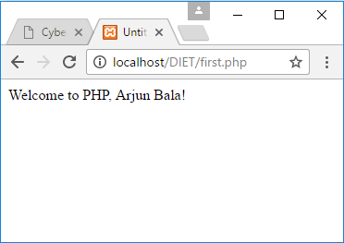
PHP Basic Example
Scripting delimiters
Declare variable $name
Single-line comment
Function print outputs the value of variable $name

Slide 213
Variables
All variables begin with $ and can contain letters, digits and underscore (variable name can not begin with digit)
PHP variables are Case-sensitive
Don’t need to declare variables
The value of a variable is the value of its most recent assignment
Variables have no specific type other than the type of their current value
Can have variable variables $$variable (not recommended)
Example : $a = “b”;
$b = “Arjun Bala”;
echo($$a);

Slide 214
Variables (Cont.)
Variable names inside strings replaced by their value
Example : $name = “Arjun Bala”;
$str = “My name is $name”;
Type conversions
settype function
Type casting
Concatenation operator
. (period)

Slide 215
Variable types
Data Type | Description
int, integer | Whole numbers (i.e., numbers without a decimal point).
float, double | Real numbers (i.e., numbers containing a decimal point).
string | Text enclosed in either single ('') or double ("") quotes.
bool, boolean | True or false.
array | Group of elements.
object | Group of associated data and methods.
resource | An external data source.
NULL | No value.

Slide 216
Variables Scope
Scope refers to where within a script or program a variable has meaning or a value
Mostly script variables are available to you anywhere within your script.
Note that variables inside functions are local to that function and a function cannot access script variables which are outside the function even if they are in the same file.
The modifiers global and static allow function variables to be accessed outside the function or to hold their value between function calls respectively

Slide 217
Example (Variables)
Assign a string to variable $testString
Assign a double to variable $testDouble
Assign an integer to variable $testInteger

Slide 218
Example (Variables) (Cont.)
Print each variable’s value
Call function settype to convert the data type of variable $testString to a double.
Call function settype to convert the data type of variable $testString to an integer.
Convert variable $testString back to a string

Slide 219
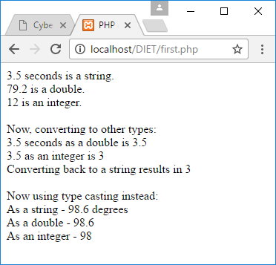
Example (Variables) (Cont.)
Use type casting to cast variable $data to different types

Slide 220
PHP Arrays
Array is a group of variable that can store multiple values under a single name.
In PHP, there are three types of array.
Numeric Array
These arrays can store numbers, strings and any object but their index will be represented by numbers. By default array index starts from zero.
Associative Array
The associative arrays are very similar to numeric arrays in term of functionality but they are different in terms of their index. Associative array will have their index as string so that you can establish a strong association between key and values.
Multidimensional Array
A multi-dimensional array each element in the main array can also be an array. And each element in the sub-array can be an array, and so on. Values in the multi-dimensional array are accessed using multiple index.

Slide 221
PHP Arrays (Example)
Create the array $first by assigning a value to an array element.
Assign a value to the array, omitting the index. Appends a new element to the end of the array.
Use a for loop to print out each element’s index and value. Function count returns the total number of elements in the array.

Slide 222
PHP Arrays (Example) (Cont.)
Call function array to create an array that contains the arguments passed to it. Store the array in variable $second.
Assign values to non-numerical indices in array $third.
Function reset sets the internal pointer to the first element of the array.
Function key returns the index of the element which the internal pointer references.
Function next moves the internal pointer to the next element.

Slide 223
PHP Arrays (Example) (Cont.)
Operator => is used in function array to assign each element a string index. The value to the left of the operator is the array index, and the value to the right is the element’s value.

Slide 224
PHP Array Functions
count($array) / sizeof($array)
Count all elements in an array, or something in an object
array_shift($array)
Remove an item from the start of an array and shift all the numeric indexes
array_pop($array)
Remove an item from the end of an array and return the value of that element
array_unshift($array,”New Item”)
Adds item at the beginning of an array
array_push($array,”New Item”)
Adds item at the end of an array

Slide 225
PHP Array Functions (Cont.)
sort($array [, $sort_flags])
Array can be sorted using this command, which will order them from the lowest to highest
If there is a set of string stored in the array they will be sorted alphabetically.
The type of sort applied can be chosen with the second optional parameter $sort_flags which can be
SORT_REGULAR compare items normally (don’t change type)
SORT_NUMERIC compare items numerically
SORT_STRING compare items as string
SORT_LOCALE_STRING compare items as string, based on the current locale
rsort($array [, $sort_flags])
It will sort array in reverse order (i.e. from highest to lowest)

Slide 226
PHP Array Functions (Cont.)
shuffle($array)
It will mix items in an array randomly.
array_merge($array1,$array2)
It will merge two arrays.
array_slice($array,$offset,$length)
returns the sequence of elements from the array $array as specified by the $offset and $length parameters.

Slide 227
PHP Functions
A function is a piece of code which takes one more input in the form of parameter and does some processing and returns a value.
Creating PHP function
Begins with keyword function and then the space and then the name of the function then parentheses”()” and then code block “{}”
<?php
function functionName() { //code to be executed; }
?>
Note: function name can start with a letter or underscore "_", but not a number!

Slide 228
PHP Functions (Cont.)
Where to put the function implementation?
In PHP a function could be defined before or after it is called.
<?php
function functionName() { //code to be executed; }
functionName();
?>
<?php
functionName();
function functionName() { //code to be executed; }
?>
Here function call is before implementation, which is also valid
Here function call is after implementation, which is valid

Slide 229
Browser Control
PHP can control various features of a browser.
This is important as often there is a need to reload the same page or redirecting the user to another page.
Some of these features are accessed by controlling the information sent out in the HTTP header to the browser, this uses the header() command such as :
header(“Location: index.php”);
We can also control the caching using same header() command
header(“Cache-Control: no-cache”);
Or can specify the content type like,
header(“Content-Type: application/pdf”);

Slide 230
Browser Detection
The range of devices with browsers is increasing so it is becoming more important to know which browser and other details you are dealing with.
The browser that the server is dealing can be identified using:
$browser_ID = $_SERVER[‘HTTP_USER_AGENT’];
Typical response of the above code is follows:
Mozilla/5.0 (Windows NT 10.0; Win64; x64) AppleWebKit/537.36 (KHTML, like Gecko) Chrome/56.0.2924.87
which specifies that user is using Chrome browser and windows 10 OS with 64 bit architecture

Slide 231
PHP String Functions
Most of the time in PHP we suppose to do manipulation of strings, wheatear it be input from the user, databases or files that have been written.
String can be think as a array of characters, so it is possible to do something like this,
$mystring = “Welcome to Darshan College of Engineering”;
print ($mystring[11]) ; // which will print ‘D’
This uses an index as an offset from the beginning of the string starting at 0
Often, there are specific things that need to be done to a string, such as reversing, extracting part of it, finding a match to part or changing case etc..

Slide 232
PHP String Functions (Cont.)
String Function | Purpose
strlen($string) | Returns length of string.
strstr($str1,$str2) | Finds str2 inside str1 (returns false if not found or returns portion of string1 that contains it)
strpos($str1,$str2) | Finds str2 inside str1 and returns index.
str_replace($search,$replace,$str[,$count]) | Looks for $search within $str and replaces with #replace, returning the number of times this is done in $count
substr($string,$startposition[,$endposition]) | Returns string from either start position to end or the section given by $startpos to $endpos
trim($string) rtrim($string) ltrim($string) | Trims away white space, including tabs, newlines and spaces, from both beginning and end of a string. ltrim is for the start of a string only and rtrim for the end of a string only

Slide 233
PHP String Functions (Cont.)
String Function | Purpose
strip_tags($string,$tags) | Strips out HTML tags within a string, leaving only those within $tags intact
stripslashes($string) | Strips out inserted backslashes
explode($delimiters,$string) | It will breaks $string up into an array at the points marked by the $delimiters
implode($array) | Function returns combined string from an array.
strtolower($string) | Converts all characters in $string to lowercase.
strtoupper($string) | Converts all characters in $string to uppercase.
ucword($string) | Converts all the first letters in a string to uppercase.

Slide 234
Form Processing
We can access form data using there inbuilt PHP associative array.
$_GET => in case we have used get method in the form
$_POST => in case we have used post method in the form
$_REQUEST => in both the cases
For example,
html
<form action=“recive.php” method=“get”>
<input type=“text” name=“UserName”>
<input type=“submit”>
</form>
recive.php
<?php
$u = $_GET[‘UserName’];
echo($u);
?>

Slide 235
File Handling in PHP
PHP has several functions for creating, reading, uploading, and editing files.
fopen($filename, $mode) will return the handle to access file.
"r" (Read only. Starts at the beginning of the file)
"r+" (Read/Write. Starts at the beginning of the file)
"w" (Write only. Opens and clears the contents of file; or creates a new file if it doesn't exist)
"w+" (Read/Write. Opens and clears the contents of file; or creates a new file if it doesn't exist)
"a" (Write only. Opens and writes to the end of the file or creates a new file if it doesn't exist)
"a+" (Read/Write. Preserves file content by writing to the end of the file)

Slide 236
File Handling in PHP (Cont.)
Function | Purpose
file_exists($file) | Will return true if file is found, false otherwise
filesize($file) | Returns the size of the file in bytes.
fread($file,$bytesToRead) | Will read $bytesToRead from $file handle
fwrite($file,$str) | Will write $str in the $file handle
fclose($file) | Will close the $file handle
copy($source,$destination) | Will copy from $source to $destination
rename($oldname,$newname) | Will rename the file to $newname
unlink($file) | Will delete the file

Slide 237
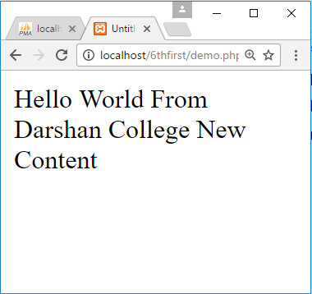
File Handling Example
text.txt
Hello World From Darshan College
Read File
<?php
$file = fopen("text.txt","a+");
$text = fread($file,filesize("text.txt"));
echo($text);
?>
Write File
<?php
fwrite($file," New Content");
$text = fread($file,filesize("text.txt"));
echo($text);
?>

Slide 238
Cookies in PHP
HTTP cookies are data which a server-side script sends to a web client to keep for a period of time.
On every subsequent HTTP request, the web client automatically sends the cookies back to server (unless the cookie support is turned off).
The cookies are embedded in the HTTP header (and therefore not visible to the users).
Shortcomings/disadvantages of using cookies to keep data
User may turn off cookies support.
Users using the same browser share the cookies.
Limited number of cookies (20) per server/domain and limited size (4k bytes) per cookie
Client can temper with cookies

Slide 239
Cookies in PHP (Cont.)
To set a cookie, call setcookie()
e.g., setcookie('username', ‘AVB');
To delete a cookie (use setcookie() without a value)
e.g., setcookie('username');
To retrieve a cookie, refer to $COOKIE
e.g. $username = $_COOKIE['username‘];
Note :
Cookies can only be set before any output is sent.
You cannot set and access a cookie in the same page. Cookies set in a page are available only in the future requests.

Slide 240
Cookies in PHP (Cont.)
setcookie(name, value, expiration, path, domain, secure, httponly)
Expiration
Cookie expiration time in seconds
0 ➔ The cookie is not to be stored persistently and will be deleted when the web client closes.
Negative value ➔ Request the web client to delete the cookie
e.g.: setcookie('username', 'Joe', time() + 1800); // Expire in 30 minutes
Path
Sets the path to which the cookie applies. (Default is ‘/’)
Domain
The domain that the cookie is available.
Secure
This can be set to 1 to specify that the cookie should only be sent by secure transmission using HTTPS otherwise set to 0 which mean cookie can be sent by regular HTTP.

Slide 241
Session in PHP
Session is a way to make data accessible across the various pages of an entire website is to use a PHP Session.
A session creates a file in a temporary directory on the server where registered session variables and their values are stored.
The location of the temporary file is determined by a setting in the php.ini file called session.save_path.
When a session is started following things happen
PHP first creates a unique identifier for that particular session which is a random string of 32 hexadecimal numbers such as 3c7foj34c3jj973hjkop2fc937e3443.
A cookie called PHPSESSID is automatically sent to the user's computer to store unique session identification string.
A file is automatically created on the server in the designated temporary directory and bears the name of the unique identifier prefixed by sess_, sess_3c7foj34c3jj973hjkop2fc937e3443.

Slide 242
Starting a PHP Session
A PHP session is easily started by making a call to the session_start() function.This function first checks if a session is already started and if none is started then it starts one.
It is recommended to put the call to session_start() at the beginning of the page.
The following example starts a session then register a variable called counter that is incremented each time the page is visited during the session.
<?php
session_start();
if( isset( $_SESSION['counter'] ) ) {
$_SESSION['counter'] += 1;
}else {
$_SESSION['counter'] = 1;
}
$msg = "You have visited this page ". $_SESSION['counter'];
$msg .= "in this session.";
?>
<html><head>
<title>Setting up a PHP session</title>
</head><body>
<?php echo ( $msg ); ?>
</body></html>

Slide 243
Destroying a PHP Session
A PHP session can be destroyed by session_destroy() function.
This function does not need any argument and a single call can destroy all the session variables.
If you want to destroy a single session variable then you can use unset() function to unset a session variable.
Logout.php
<?php
session_destroy();
?>
Logout.php
<?php
unset(S_SESSION[‘counter’]);
?>

Slide 244
Object Oriented Concepts
Classes, which are the "blueprints" for an object and are the actual code that defines the properties and methods.
Objects, which are running instances of a class and contain all the internal data and state information needed for your application to function.
Encapsulation, which is the capability of an object to protect access to its internal data
Inheritance, which is the ability to define a class of one kind as being a sub-type of a different kind of class (much the same way a square is a kind of rectangle).
Polymorphism, which means that, depending on the circumstances, an object will act diffrently.

Slide 245
Creating Class
Let's start with a simple example. Save the following in a file called MyClass.php:
MyClass.php
<?php
class Demo
{
// Code Here
}
?>

Slide 246
Adding Method
The Demo class isn't particularly useful if it isn't able to do anything, so let's look at how you can create a method.
MyClass.php
<?php
class Demo
{
function SayHello($name)
{
echo “Hello $name !”;
}
}
?>

Slide 247
Adding Properties
Adding a property to your class is as easy as adding a method.
There are three different levels of visibility that a member variable or method can have :
Public : members are accessible to any and all code (Default)
Private : members are only accessible to the class itself
Protected : members are available to the class itself, and to classes that inherit from it
MyClass.php
<?php
class Demo{
public $name;
function SayHello($name){
echo “Hello $name !”;
}
}
?>

Slide 248
Constructor / Destructor
Constructor is the method that will be implemented when object has been initiated, Commonly, constructor is used to initialize the object
Use function __construct (also referred as Magic Function) to create constructor in PHP
MyClass.php
<?php
class Demo{
function __construct
{
}
function __destruct
{
}
}
?>

Slide 249
Inheritance
Human.php
<?php
class Human{
private $name = “a”;
public function getName() {
return $this->name;
}
}
?>
Student.php
<?php
class Student extends Human{
private $rollno = “001”;
public function getRoll() {
return $this->rollno;
}
}
?>
Faculty.php
<?php
class Faculty extends Human{
private $staffInitial = “abc”;
public function getInitial() {
return $this->staffInitial;
}
}
?>
My.php
<?php
$mystu = new Student();
$mystu->getRoll();
$mystu->getName();
$myfac = new Faculty();
$myfac->getName();
$myfac->getInitial();
?>

Slide 250
Unit-7
PHP & MySQL

Slide 251
Outline
Connection to the Server
Creating a Database
Selecting a Database
Listing Database
Listing Table Names
Creating a Database Table
Inserting Data
Altering Tables
Deleting Databases
Select Queries
Accessing the Result

Slide 252
Connection to the Server
To connect with PHP the mysql_connect command can be used
You may use the code fragment :
<?php
mysql_connect(server,username,password);
?>
<?php
$connect = mysql_connect(“localhost”,”root”,””);
?>

Slide 253
Creating a Database
To create a database, use the SQL command :
You may use the code fragment :
SQL Query
CREATE DATABASE databasename
<?php
mysql_connect(“localhost”,”root”,””);
$sql = “CREATE DATABASE DemoDatabase”;
mysql_query($sql);
?>

Slide 254
Selecting a Database
Before actually use a database we need to select it as below
The die command stops further script processing with an error message if the database cannot be selected.
<?php
mysql_select_db(“DemoDB”) or die (“Can not Select Database”);
?>

Slide 255
Listing Database
In SQL show databases will display all the current databases.
One way to do the same in PHP is :
Note: mysql_tablename is generalized function for table/dastabase name
Note: mysql_tablename is depricated function and should not be used
SQL Query
SHOW DATABASES
<?php
$result = mysql_list_dbs($connect);
for($row=0;$row<mysql_num_rows($result);$row++)
{
$dbases .= mysql_tablename($result,$row) . “<br/>”;
}
echo($dbases);
?>

Slide 256
Listing Table Names
In SQL show tables will display all the current tables.
One way to do the same in PHP is :
Note: mysql_tablename is generalized function for table/dastabase name
Note: mysql_tablename is depricated function and should not be used
SQL Query
SHOW TABLES
<?php
$result = mysql_list_tables($db);
for($row=0;$row<mysql_num_rows($result);$row++)
{
$tables .= mysql_tablename($result,$row) . “<br/>”;
}
echo($tables);
?>

Slide 257
Creating a Database Table
A database table is made in both the PHP and directly with the same monitor using basically the same command, which is
In case of PHP the command is actually made up as a string and then submitted using the mysql_query command :
SQL Query
CREATE TABLE tablename (fileds);
<?php
$sql = “CREATE TABLE demo (” .
“id INT NOT NULL AUTO_INCREMENT, “ .
“name VARCHAR(50) NOT NULL, “ .
“PRIMARY KEY(id))”;
mysql_query($sql);
?>

Slide 258
Inserting Data
Data is inserted into a database table in the MySQL monitor using insert query:
In case of PHP the command is actually made up as a string and then submitted using the mysql_query command :
SQL Query
INSERT INTO demo (id,name) values (NULL,’avb’)
<?php
$sql = “INSERT INTO demo (id,name) values (NULL,’$name’)”;
mysql_query($sql);
?>

Slide 259
Altering Tables
To alter table using database monitor we can use following SQL query :
In case of PHP the command is actually made up as a string and then submitted using the mysql_query command :
SQL Query
ALTER TABLE demo modify name varchar(30);
<?php
$sql = “ALTER TABLE demo modify name varchar(30)”;
mysql_query($sql);
?>

Slide 260
Deleting Databases
To delete the database we can use following SQL Query
In case of PHP the command is actually made up as a string and then submitted using the mysql_query command :
SQL Query
DROP DATABASE dbname
<?php
$sql = “DROP DATABASE dbname”;
mysql_query($sql);
?>

Slide 261
Select Queries
Once we have set up a database with information, queries can be applided to actually find information
In case of PHP the command is actually made up as a string and then submitted using the mysql_query command, it will return an result which can then be manipulated to get desired output:
SQL Query
SELECT * FROM demo where ………………….
<?php
$sql = “select * from demo”;
$result = mysql_query($sql);
?>

Slide 262
Accessing the Result
We have 3 methods to access the result generated from the select query :
$row = mysql_fetch_row($result)
Result can be accessed using numeric index starting from 0.
Ex : echo($row[1]); // in our demo table it will return name as it is in 1 index.
$row = mysql_fetch_assoc($result)
Result can be accessed using string index where index is the column name.
Ex : echo($row[‘name’]);
$row = mysql_fetch_array($result)
Result can be accessed using numeric as well as string index
Ex : echo($row[1]); // in our demo table it will return name as it is in 1 index
Or
Ex: echo($row[‘name’]); // both will be valid and will return same

Slide 263
Accessing the Result (Cont.)
<?php
$sql = “select * from demo”;
$result = mysql_query($sql);
while($row = mysql_fetch_row($result))
{
echo($row[1] . “<br/>”);
}
OR
while($row = mysql_fetch_assoc($result))
{
echo($row[‘name’] . “<br/>”);
}
OR
while($row = mysql_fetch_array($result))
{
echo($row[0] . “ ”. $row[‘name’] . “<br/>”);
}
?>

